Slide 1




We Keep Healthcare Healthy™
We make medical equipment rental simple and facility hygiene better.

Slide 2
Problems long-term care leaders are facing today
HAIs are continual problem in long-term care facilities
Staff shortage is
a new normal
Shortages on
medical equipment are driving up costs
Lack of reporting visibility causing overspend
Variable, uncontrollable expenses reducing margins
Interest rate hikes causing purchasing equipment to be unattainable

Slide 3
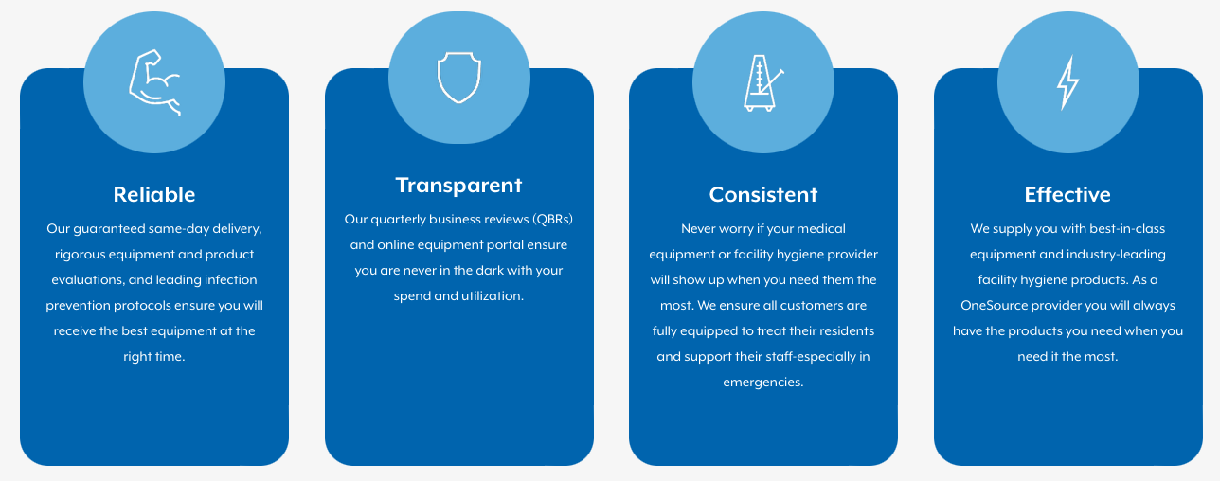
The MasVida Difference
Our Promise: Reliable. Transparent. Consistent. Effective.

Slide 4
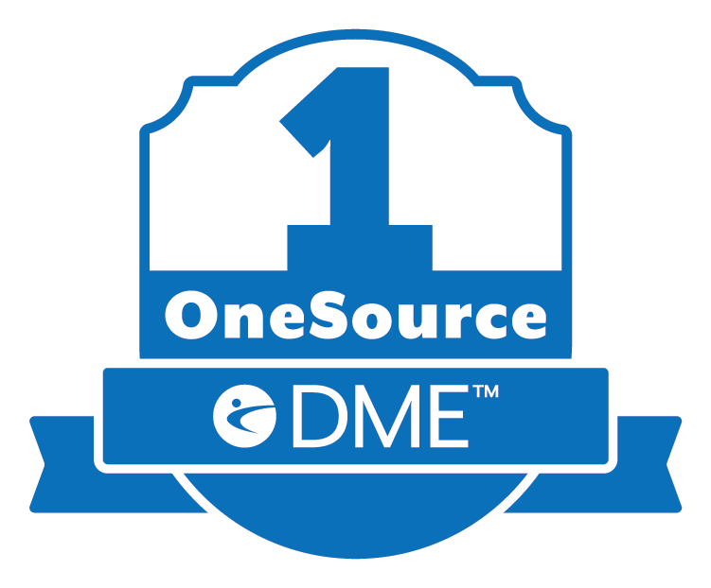
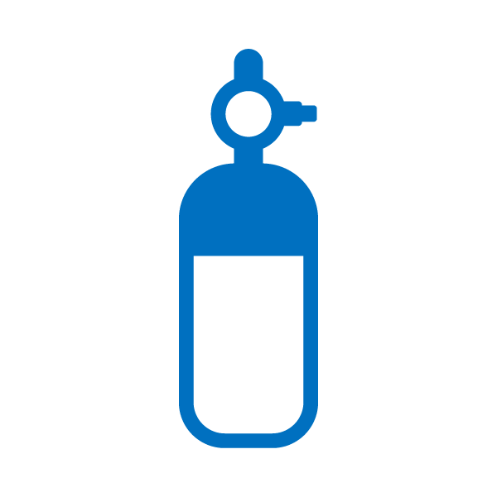








OneSource: Your Single Source for Same-day DME Delivery and Better Facility Hygiene
We are one, single provider to service all medical equipment and facility hygiene needs.
Medical Oxygen Therapy
Negative Pressure Wound Therapy
Respiratory Therapy
Durable Medical Equipment

Slide 5

OneSource: Your Single Source for Same-day DME Delivery and Better Facility Hygiene
One report. One provider. One invoice.
One report: Our online portal is open source, allowing integration into DSSI and PPC. See all your rentals, oxygen, NPWT, and facility hygiene spend in one easy-to-use dashboard.
One provider: Same-day delivery in every county in Texas. Guaranteed. Always get your equipment to the right patient, at the right time.
One invoice: Predictable, consistent billing. Transparent costs evaluated quarterly at QBRs.

Slide 6

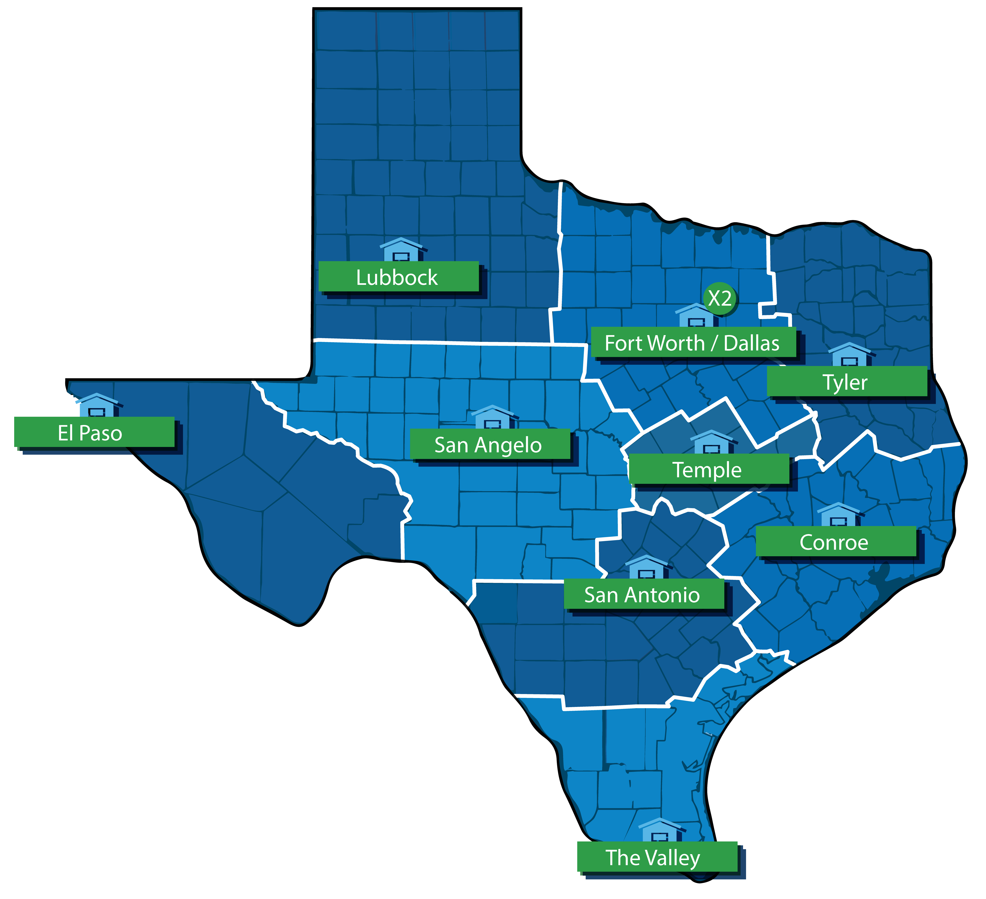
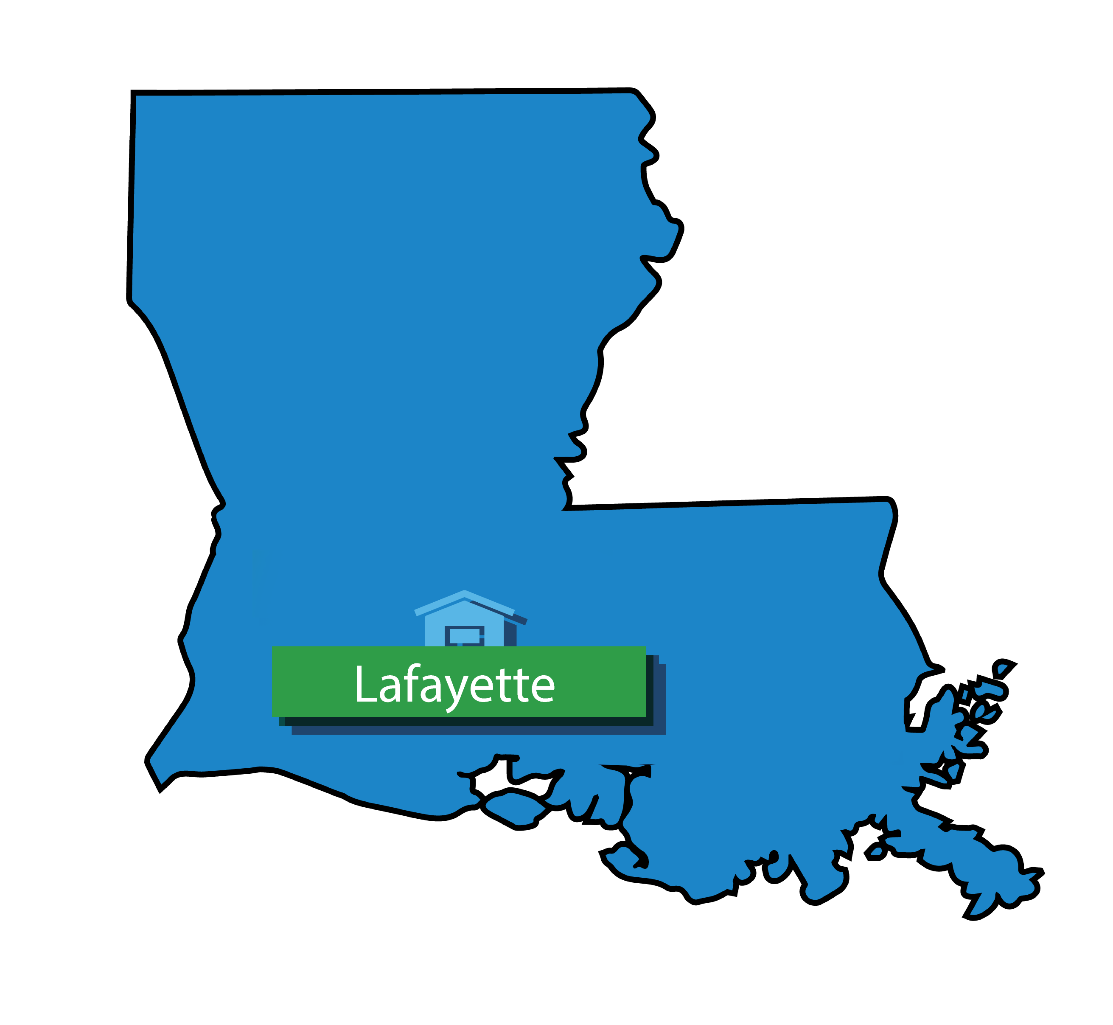
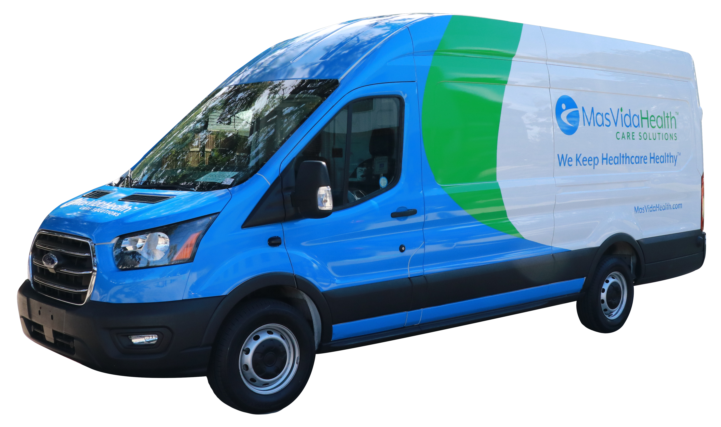
Same-Day Delivery. Guaranteed.
We service 100% of Texas, Oklahoma, and Louisiana with same-day and 24/7 emergency deliveries.
When you partner with MasVida in any of our OneSource solutions you will receive a same-day option on all your deliveries. This service, along with a 24/7 emergency service option, is included in our flat, predictable pricing model. No hidden fees. Complete transparency.

Slide 7
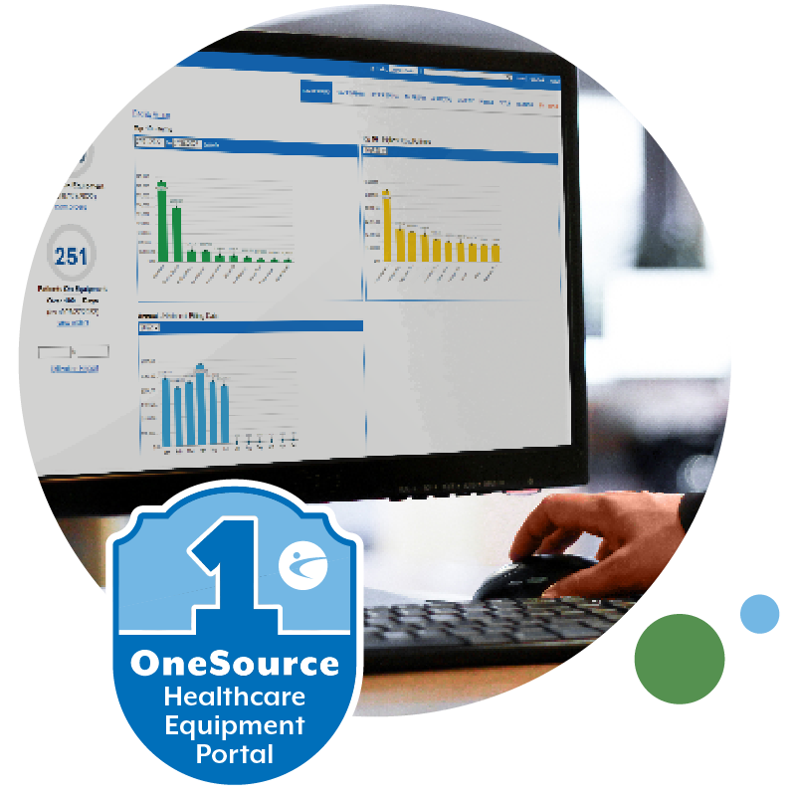



OneSource Healthcare Equipment Portal
As a service to our customers, OneSource Healthcare Equipment Portal makes real-time equipment management easier, convenient, and better. It becomes your one-stop shop dashboard to get proactive insights and services right from your desktop 24/7.
Integrates with PointClickCare and DSSI
View and track detailed invoices
Imports new patient demographics like: Name, DOB, Address, Height, and Weight
Easy Connect
Better Operational Efficiency
Improves Your Financial Performance

Slide 8



Creating healthier spaces
OneSource Healthcare Solutions
Keeping residents safe
Medical Oxygen Therapy
Negative Pressure Wound Therapy
Respiratory Therapy
Durable Medical Equipment
Infection Prevention and Cleaning Program (MViP)
Providing more comfortable care

Slide 9



MasVida Durable Medical Equipment (DME)
We Make Medical Equipment Rental Simple
Reliable equipment delivery: Enjoy quick and reliable same-day delivery of medical equipment orders.
We meet all your DME needs: Our wide selection of basic and advanced medical equipment (standard DME, oxygen cylinders, NPWT, respiratory/vents) covers all of your healthcare needs.
Easy-to-use portal: Our user-friendly portal helps you effortlessly manage all your rentals in real time.
Medical Oxygen
Therapy
Negative Pressure Wound Therapy (NPWT)
Respiratory Therapy
Durable Medical Equipment

Slide 10
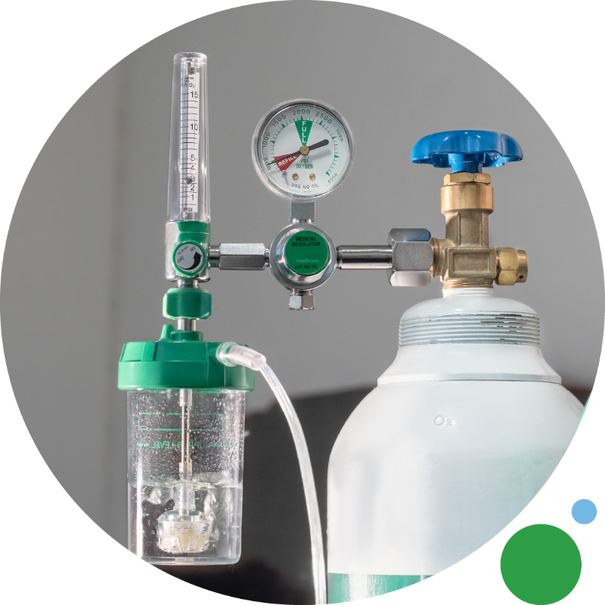
Medical Oxygen Therapy
We make oxygen rental and refill simple and easy.
Remove the headache associated with providing oxygen for your residents. We make oxygen rental and refill simple and easy with one predictable daily rate and PPD or per tank pricing options. If you are looking for oxygen tank rental for short or long-term use, we offer cylinders of various sizes to meet your needs for a flat, predictable monthly fee or per diem.
Scheduled deliveries: weekly, bi-weekly, or monthly.
Faster delivery for emergency orders.
Set-up and stored in designated area.
Empty tanks picked up with full tank delivery
No hidden fees such as weekend delivery fees or HAZMAT fees.

Slide 11
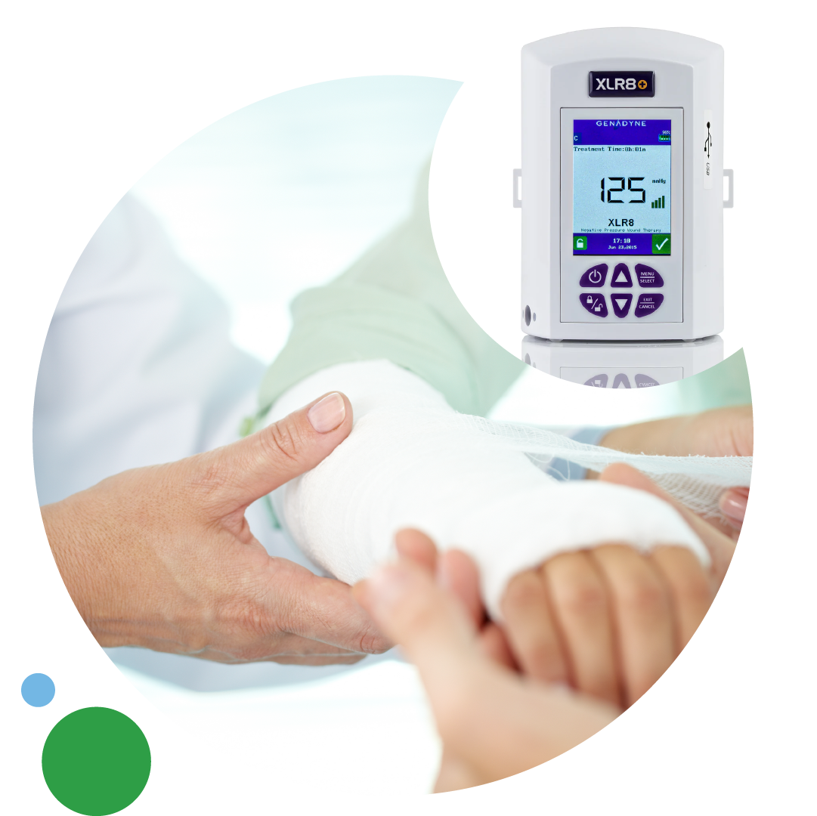
Negative Pressure Wound Therapy (NPWT)
Better wound care in less time.
Accelerate healing with leading negative pressure wound therapy technology, best-in-class wound care supplies, industry-leading sleeping surfaces, and therapeutic seating solutions. Wound management is made simple through our bundled rental and supplies program at a predictable daily rate.
Simple, transparent bundled solutions for one low rate.
Order supplies as needed – typically shipped same day.
Faster healing – better outcomes.
Decreases the chance of wound infections.
Shortens LOS.

Slide 12




&
Partnering with the Best in Wound Therapy
Promoting Better Wound Healing in Less Time
Restorix Clinical Advantage
Never Turn Down a Referral
Reduce Therapy Days & Increase Margin
Restorix provides clinical oversight, managing NPWT utilization to increase outcomes and reduce costs. MasVida Health will act as the distributor and supplier of the NPWT pumps.
NPWT systems allow patients to be discharged from the hospital with the NPWT pump, strengthening the partnership with referral relationships. The patient and their families are more comfortable, enhancing community value and patient quality of life.
Our partnership offers a bundled flat rate cost or per day rate. The enhanced clinical support and training will reduce consumable waste, streamline dressing changes to decrease labor cost, and with additional support coupled with the dedicated NPWT portal, utilization days can be reduced.

Slide 13
The Ordering Process
MasVida will two-day ship to all facilities in the U.S.
Simple. Transparent. Easy. Bundled solution for one low rate.
Order supplies as needed.
Faster healing. Better outcomes.
Facility Orders Through our OneSource Portal
Facility Packs and Requests FedEx pickup for Return
MasVida Two-day Ships the Pump
Facility Receives Pump and Treats Patient

Slide 14

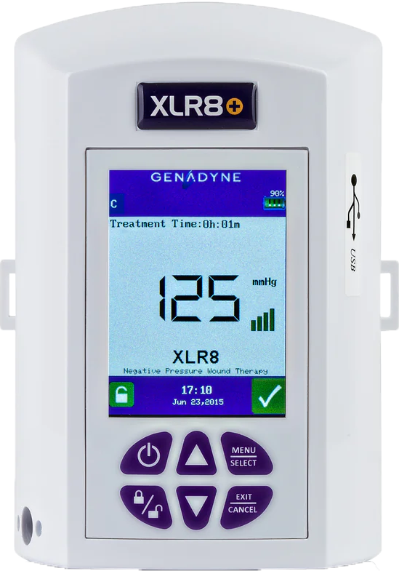
Leading the Industry in Traditional Negative Pressure Wound Therapy
Traditional (t)NPWT
GENADYNE XLR8+ NPWT PUMP
Ideal for wounds greater than 0.3mm in depth
Continuous and variable pressure setting options
Intensity level setting options
FDA approved for both acute and post-acute care
Exclusive Partnership Bundle:
XLR8+ Negative Pressure Wound Pump
3 Foam Kits
2 Canisters

Slide 15
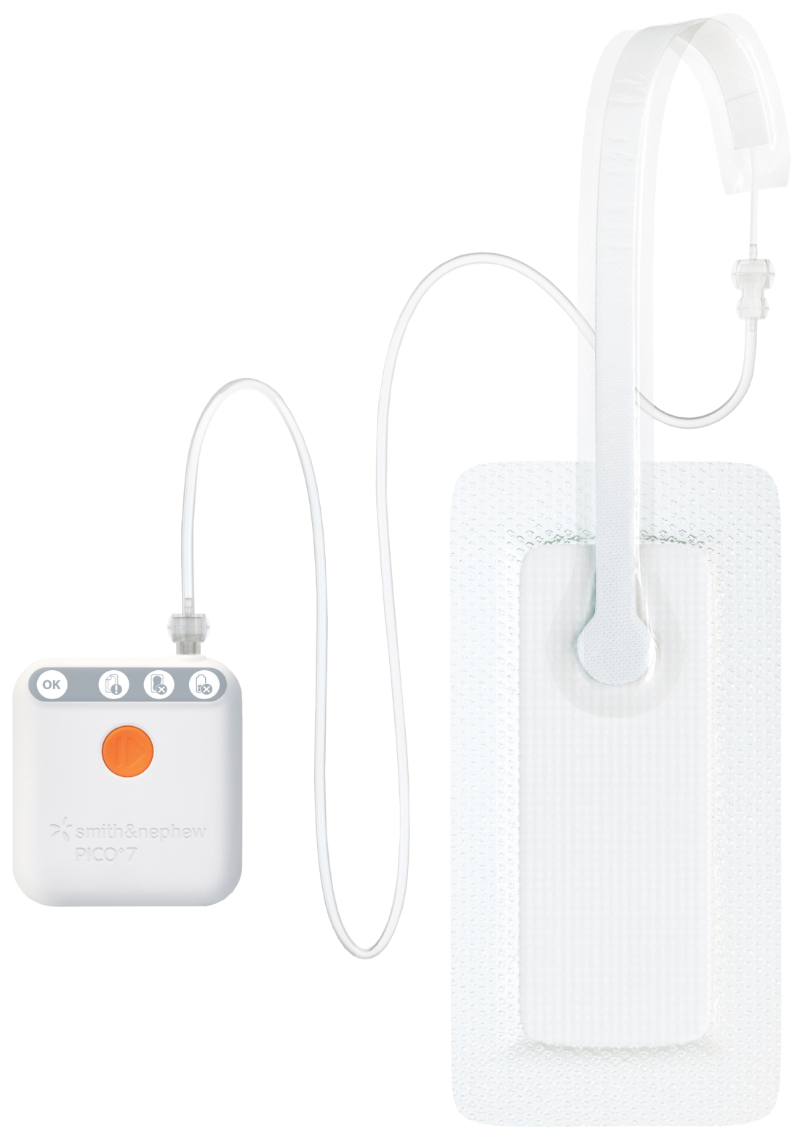

Leading the Industry in Single-use Negative Pressure Wound Therapy
Single-use (s)NPWT
PICO sNPWT PUMP
Ideal for shallow wounds and incision lines
Manages low to moderate levels of exudate
Delivers compression-like therapy to the wound, wound margin, and periwound
Canister-free and portable, which can help improve patient mobility and increase satisfaction rates
Exclusive Partnership Bundle:
PICO 7 or 14 Single-use NPWT Pump
Various Sized Dressings

Slide 16
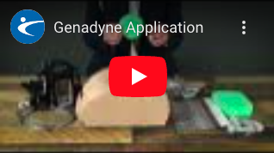
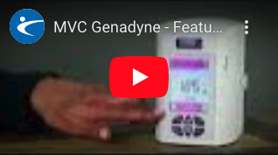
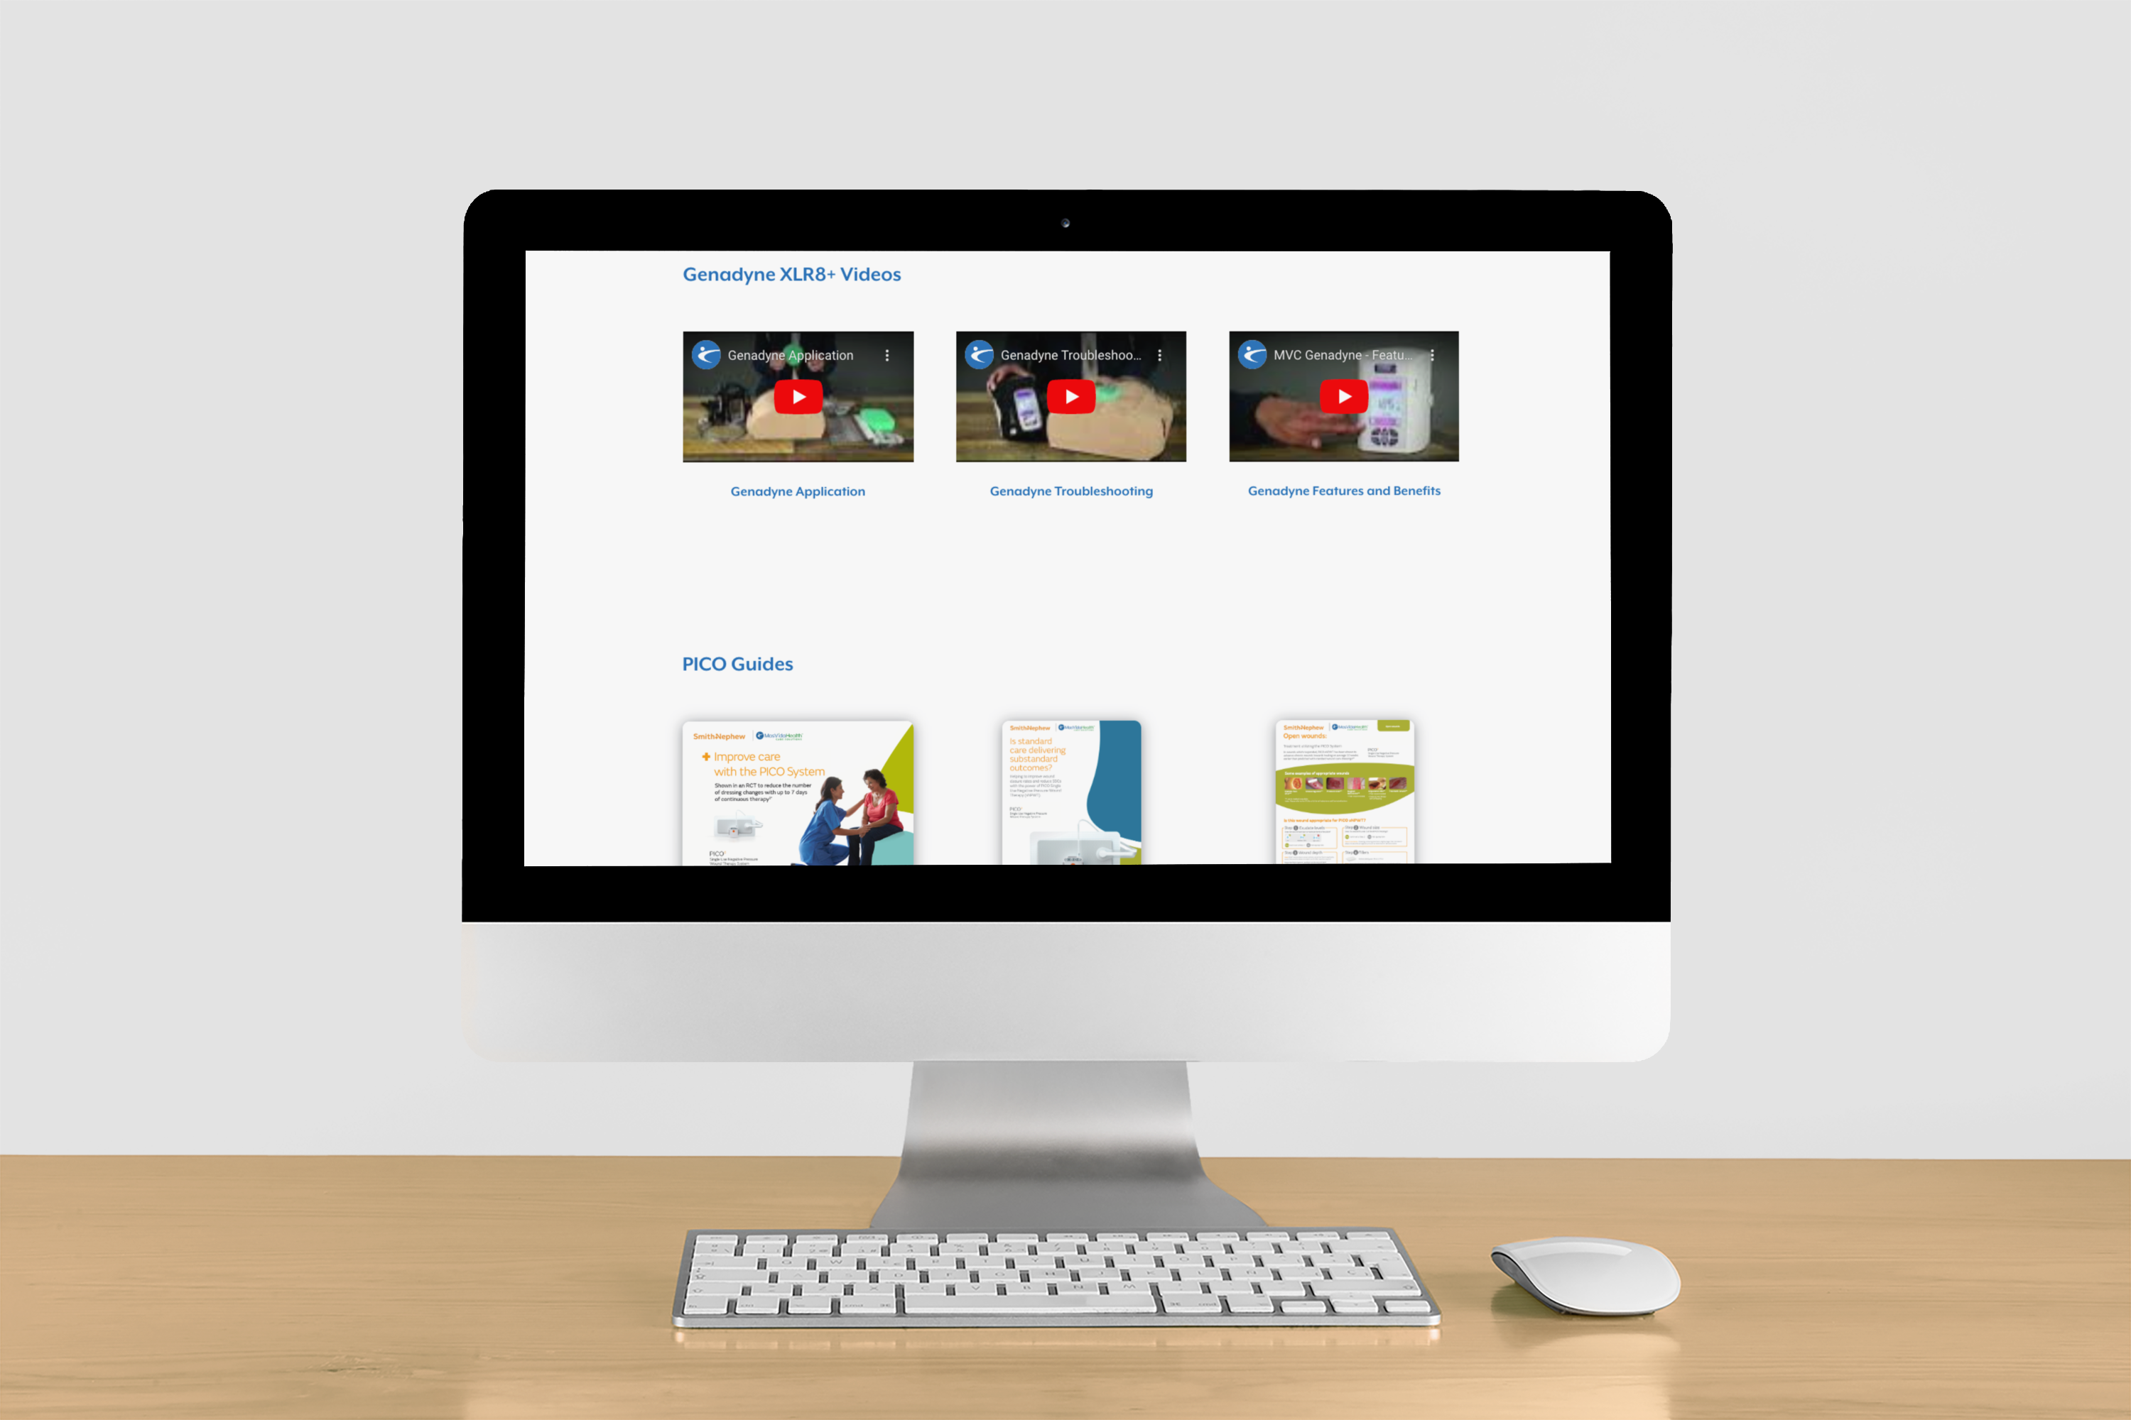
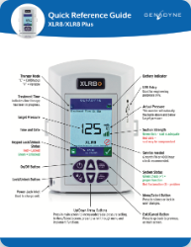
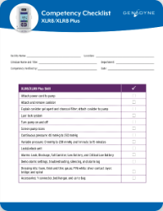
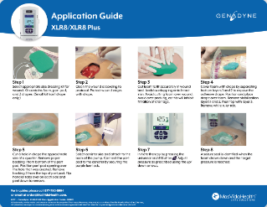
Online NPWT Toolkit with Videos and Downloadable Guides
Access by visiting MasVidaHealth.com/tookit or by scanning the QR code!
Scan for access!

Slide 17
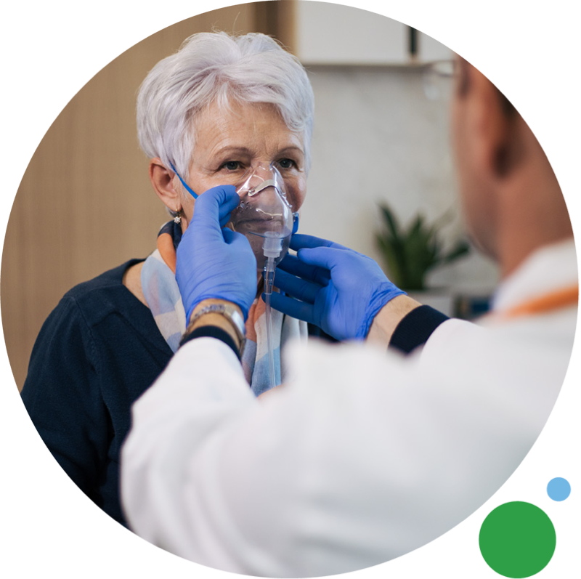
Respiratory Therapy
Reliable and robust respiratory equipment for better outcomes.
Get your residents the high-acuity treatment they need with a reliable and robust respiratory program. We bundle your rentals with your supplies at a predictable daily rate to make your respiratory equipment easy to manage.
Get the respiratory equipment you need to effectively serve your patients.
Package your supplies with your rental for a predictable daily rate.
24/7 certified on-staff clinical respiratory therapists available.
A Director of Clinical Respiratory Services will be assigned for oversight and supervision of all clinical respiratory services provided by us.

Slide 18

Durable Medical Equipment (DME)
Our DME rental is reliable, fast, and easy.
Your residents deserve reliable medical equipment for their unique needs. Get reliable and affordable DME delivered same-day. Guaranteed.
All our equipment is best-in-class.
Our online portal technology increases operational efficiency and improves your bottom-line.
OneSource: Consolidate your many vendors to one single point of contact for all your DME.
Reliable. Fast. Easy. We provide a turn-key approach from ordering and delivery to maintenance and pick-up.
Bundled rentals and supplies at one predictable daily rate.

Slide 19




MasVida Infection Prevention and Control (MViP)
We Make Facility Hygiene Better
All-in-one IPC solution: MViP provides everything you need for infection prevention and cleaning, keeping your space healthy for everyone.
Save money with bundles: Choose the products you need and enjoy discounts by bundling them together in a predictable subscription plan.
Easy to use products: Our high-quality hygiene products easily fit into your daily cleaning routines, making your facility cleaner and safer every day.

Slide 20
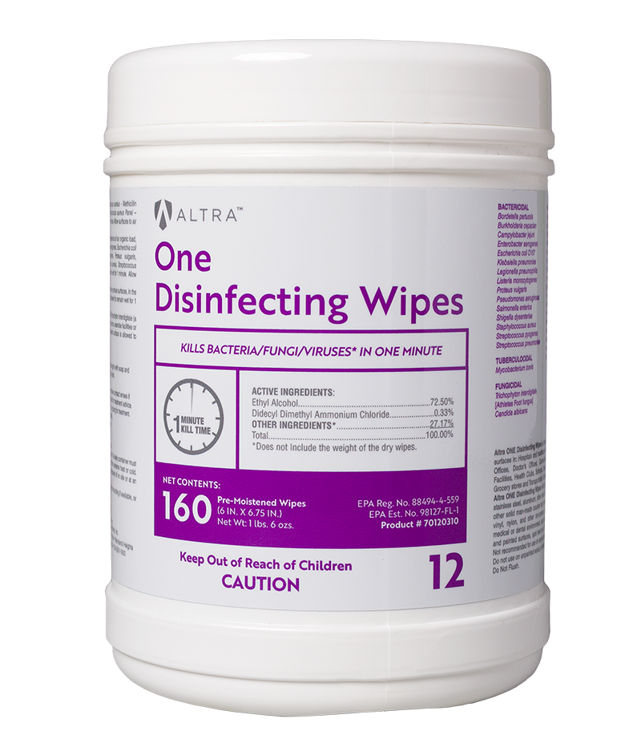
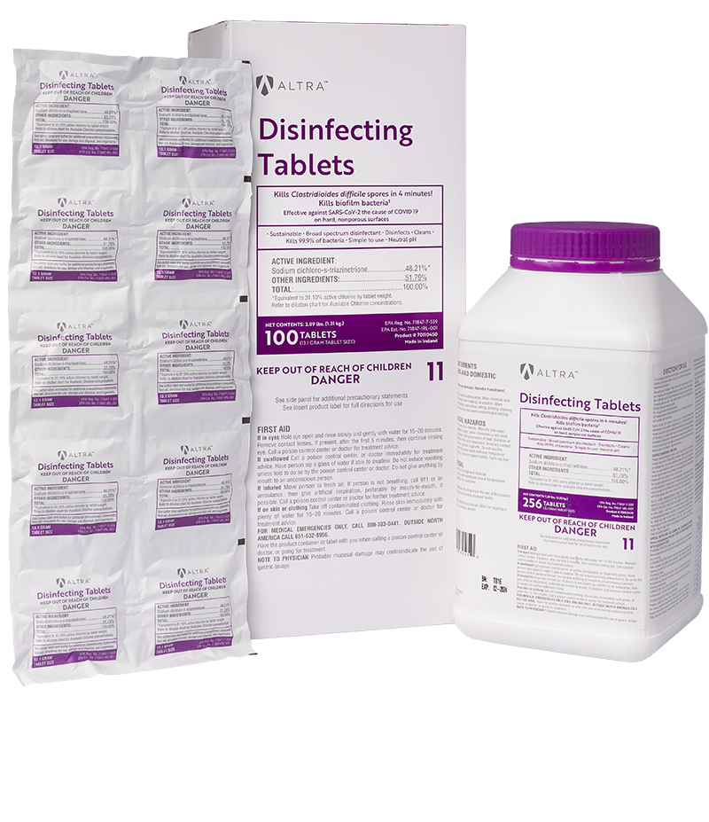
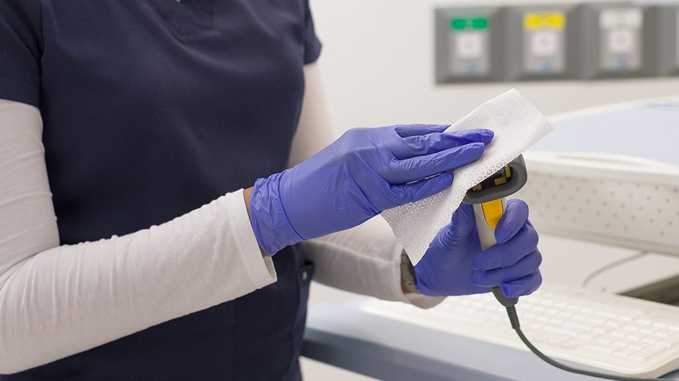
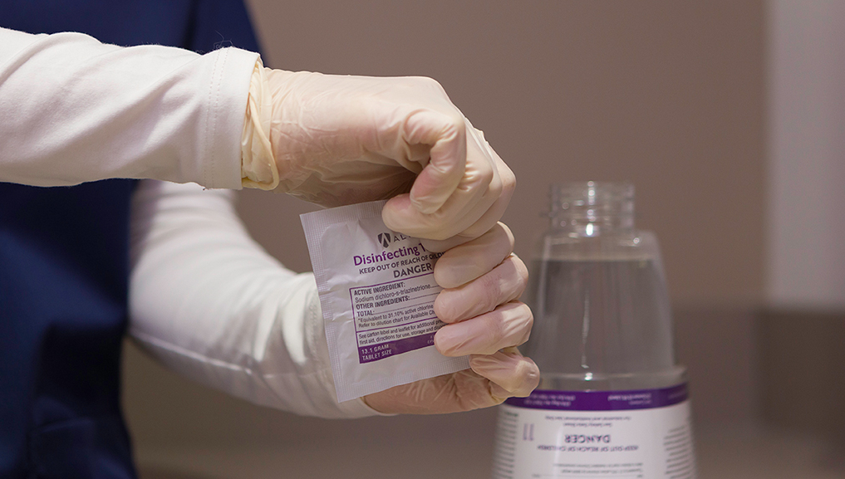
Disinfection Products
Keeping Our Residents and Staff Safe and Healthy
Altra Disinfecting Tablets
Altra One Disinfecting Wipes
Altra Disinfecting Tablets are EPA registered and capable of killing clostridioides difficile spores in four minutes. These easy-to-use tablets help reduce cross-contamination on hard, non-porous surfaces by acting against a broad spectrum of microorganisms.
Altra One Disinfecting Wipes will not harm most surfaces, including stainless steel, aluminum, other hard and soft metals, sealed quartz or other solid man-made countertop materials, most plastics, fiberglass, vinyl, nylon, and other non-porous upholstery materials used in a medical or dental environment, and most painted surfaces.

Slide 21
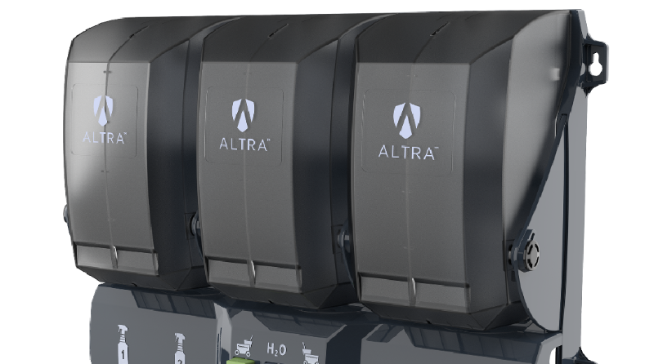
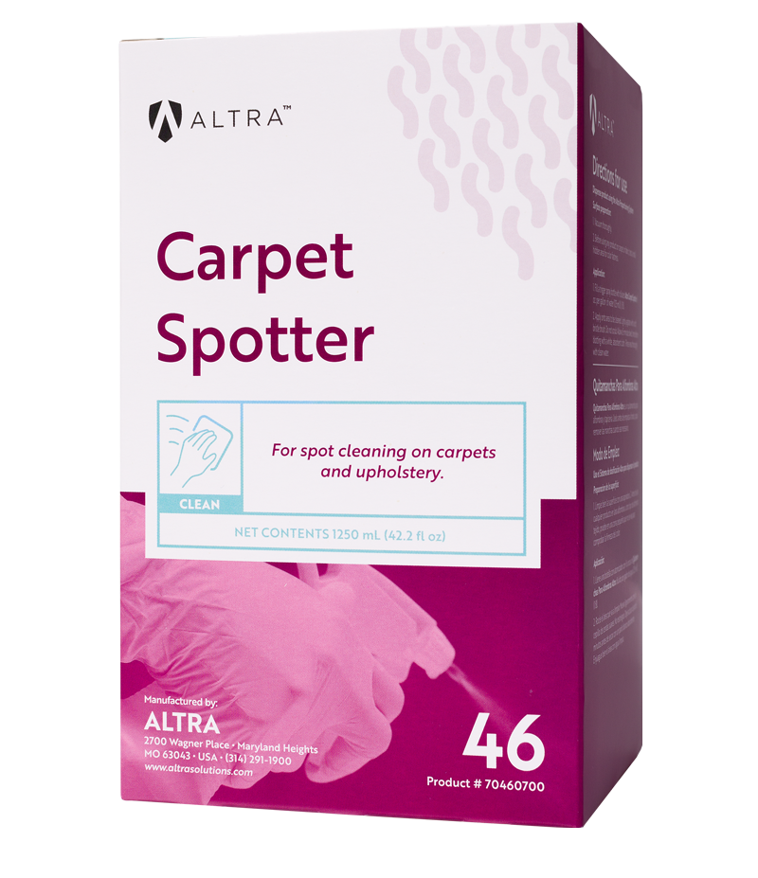
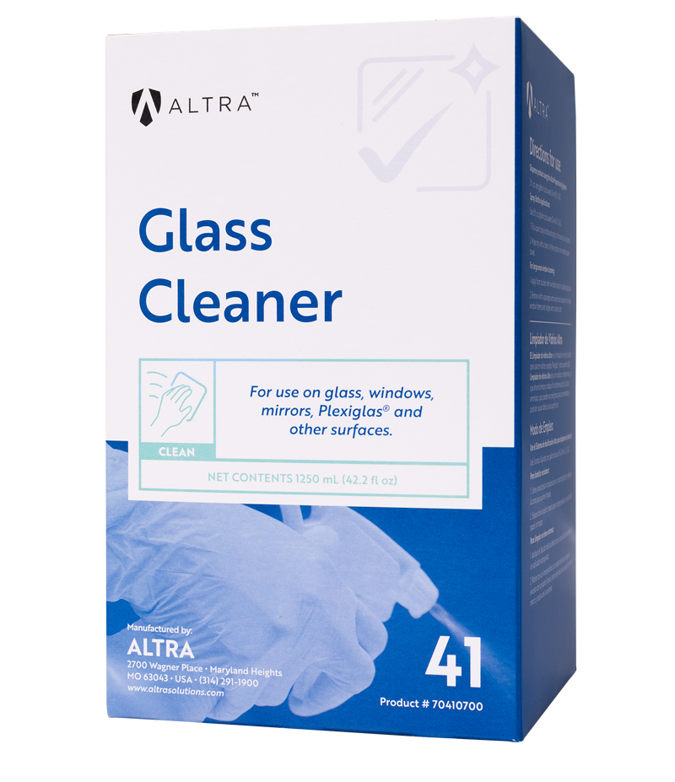

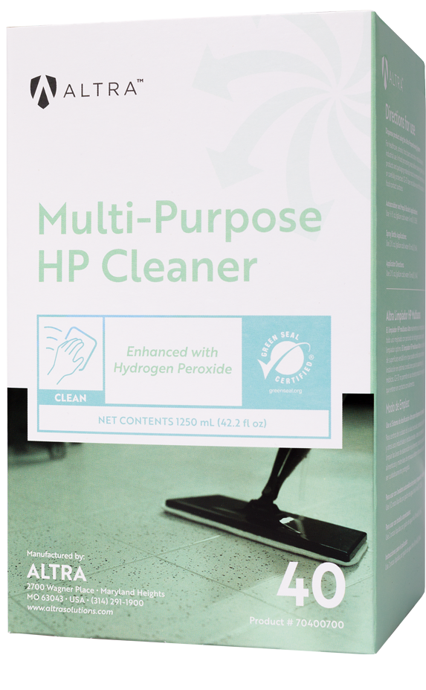
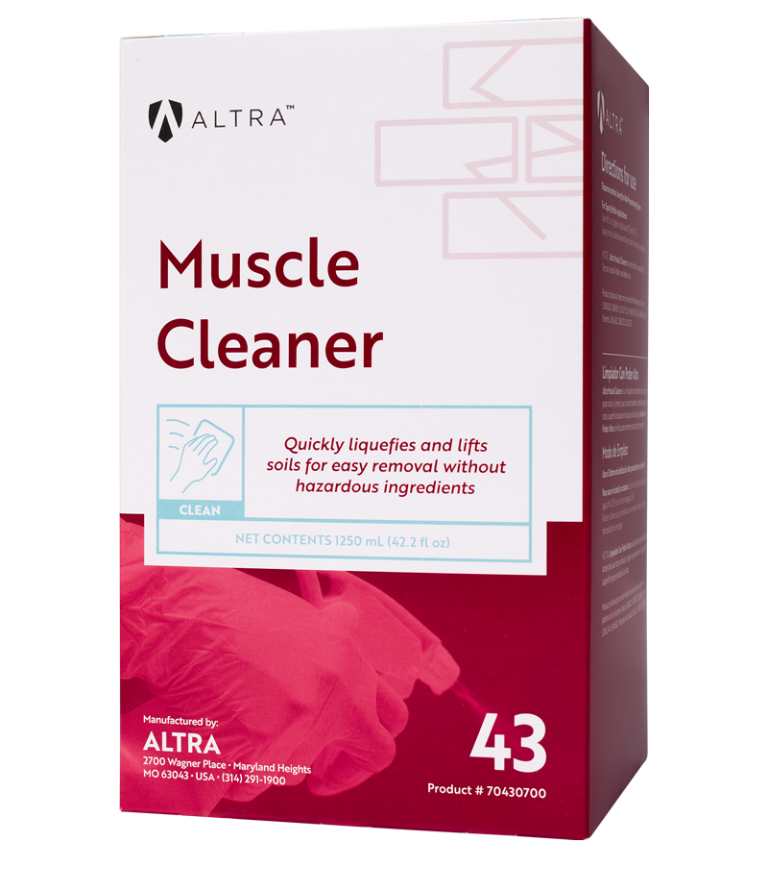

Cleaning Products
Dynamic, Robust, and Effective Cleaning Solutions
Altra Proportioning System
Altra Suite of Cleaning Products
The Altra Proportioning System is designed for Environmental Services (EVS) personnel and the challenges they face in healthcare facilities. Our proportioning systems are user-friendly and cost-effective for all healthcare facilities with economically and ecologically friendly products.
Altra Cleaners do not contain potentially hazardous ingredients including butyl, solvents, and alcohol bases. They are formulated for sensitive continuum of care equipment, patients, visitors and staff. Altra’s sustainable cleaning program can be customized to fit your hospital’s needs, including space, cost, and security requirements.

Slide 22
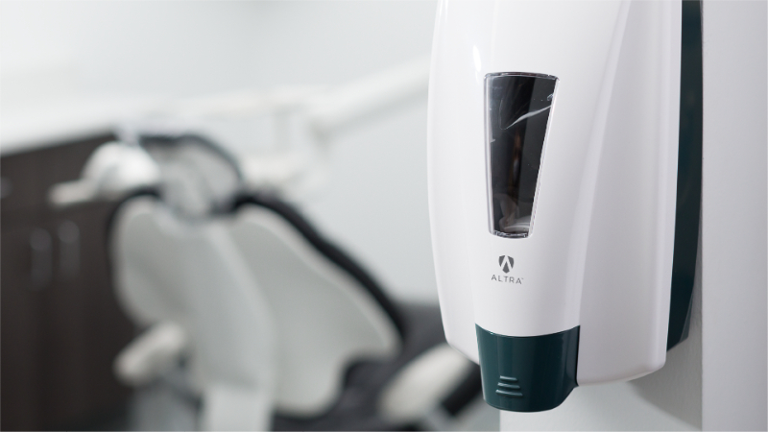
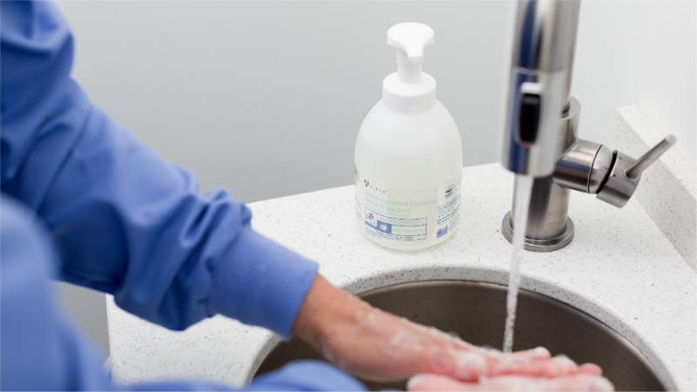
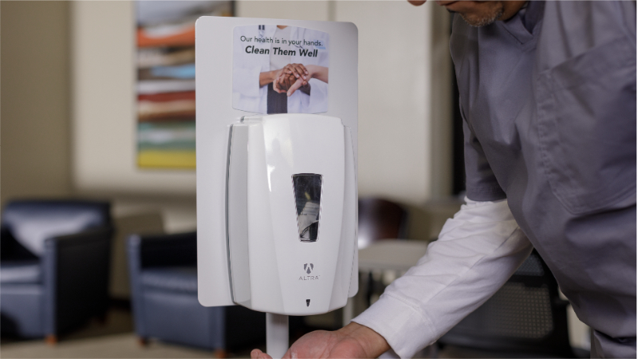
Hand Hygiene Program
Hand Hygiene Products People Want to Use
Altra Hand Wash and Sanitizing Dispensers
Altra Foaming Hand Wash and Hand Sanitizers
ABMS: Altra Behavior Modification
Altra dispensers have large sight windows for checking product levels, are available with hidden locks or keyed, and may be customized with your logo, message, and color.
Our line of foaming and waterless hand sanitizer and hand washes reduce common disease-causing bacteria. Altra products have a mild, sweet fragrance (Fragrance-free available). It is ideal for healthcare.
Altra utilizes behavioral science to drive hand hygiene practices. As a value-added component of our program, the ABMS is a set of unique placards and signs with messages designed to inspire and maximize hand hygiene practices.

Slide 23
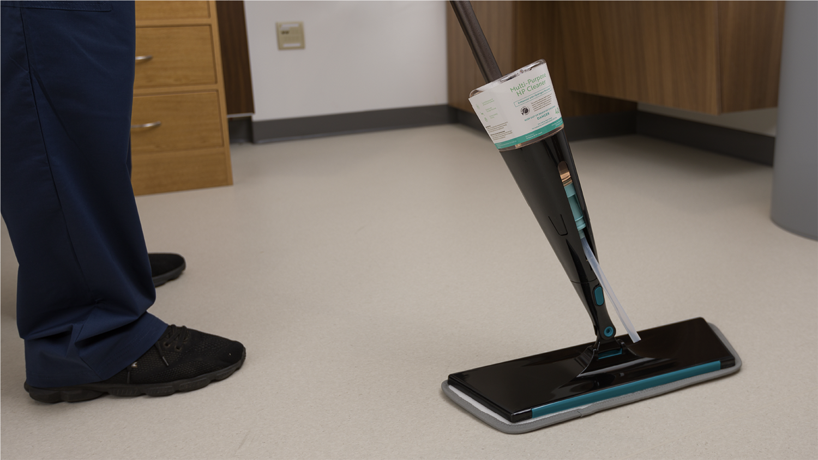
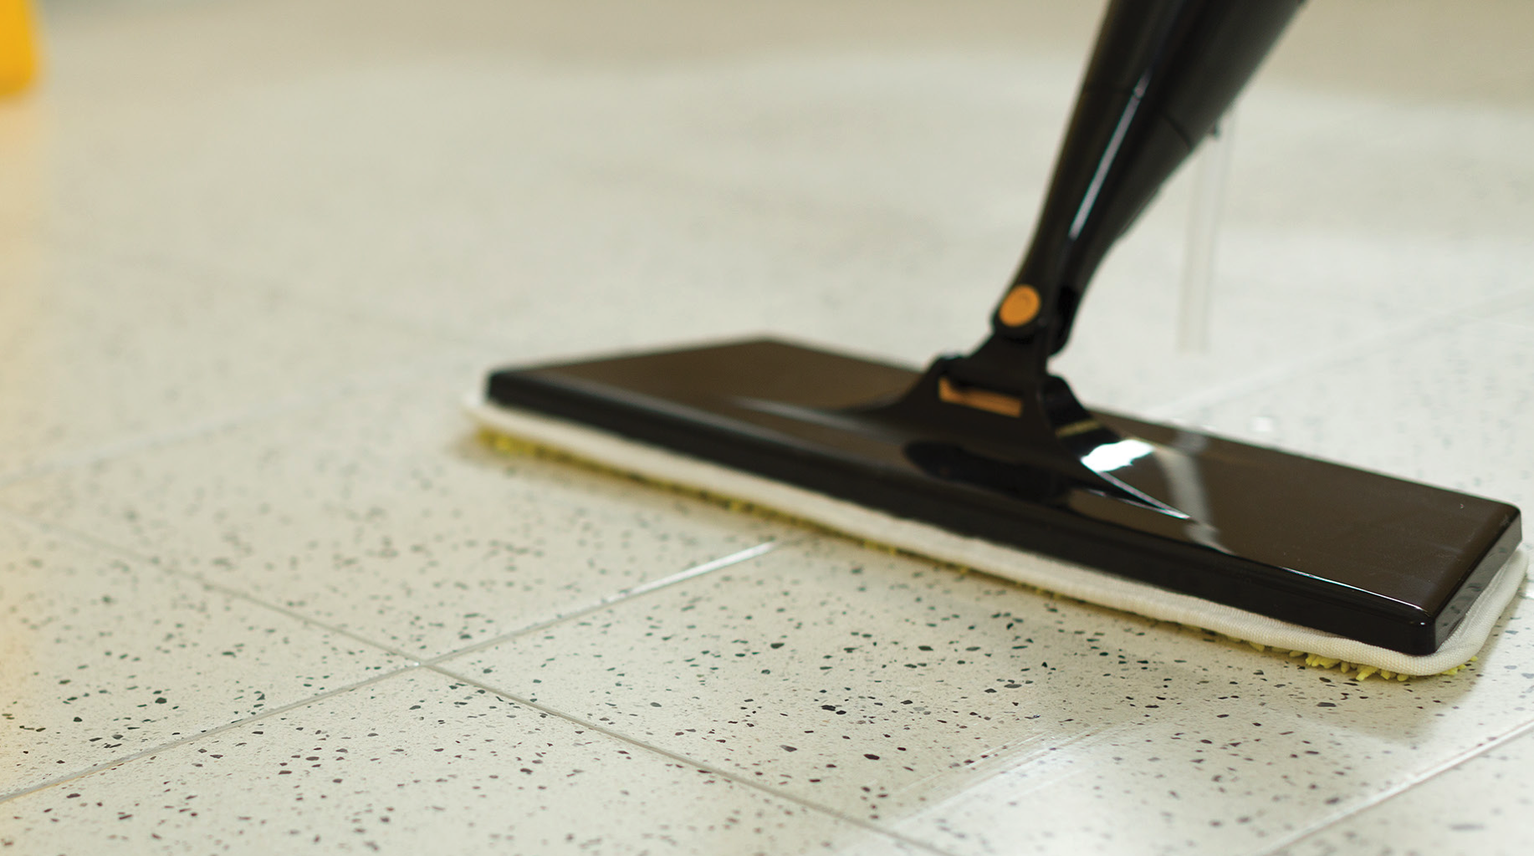
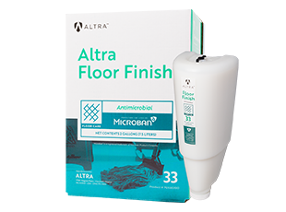
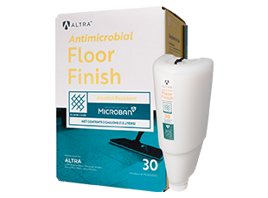
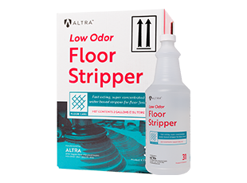
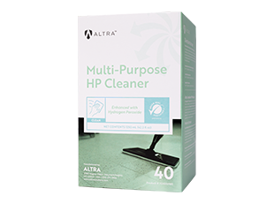
Floor Care Program
Proven to Standardize Floor Care and Increase Efficiency
Altra Lite Applicator
Altra Preserve
Altra Suite of Floor Care Product
Compatible with Altra proportioning systems, the Altra Lite Applicator promotes efficiency and reduces worker fatigue with its ergonomic design.
Altra Preserve is a strip-free floor coating formulated to extend the life of specialty flooring, including LVT. It protects the floor, creating a soft, more natural look.
Healthcare floors can be a breeding ground for bacteria. Developing a floor care program that inhibits bacteria growth on floors and combats all forms of wear and tear can help keep your facility cleaner and looking its best.

Slide 24



Case Study
When all of your DME is completely taken care of, and your entire infection prevention and cleaning program is streamlined, you can execute a lot of other patient driven solutions. This is the power of MasVida.
Gary Blake, CEO Creative Solutions in Healthcare

Slide 25
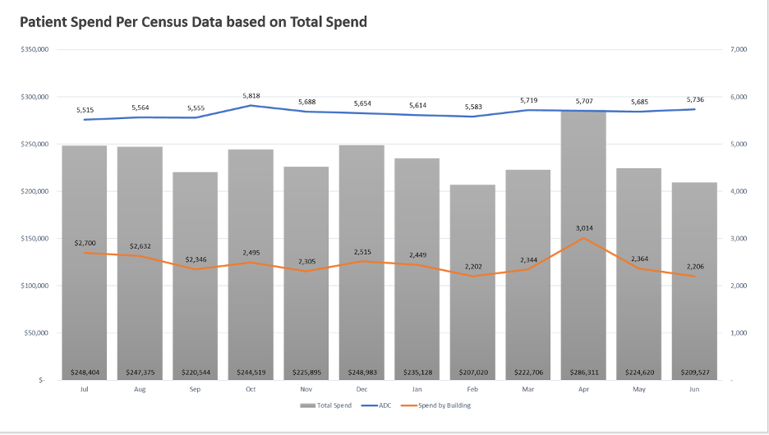
Patient Spend Per Census Data | Total Spend

Slide 26
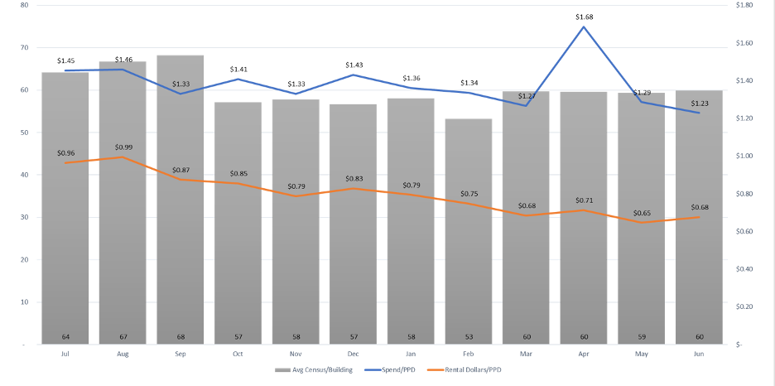
ADC and Spend PPD

Slide 27
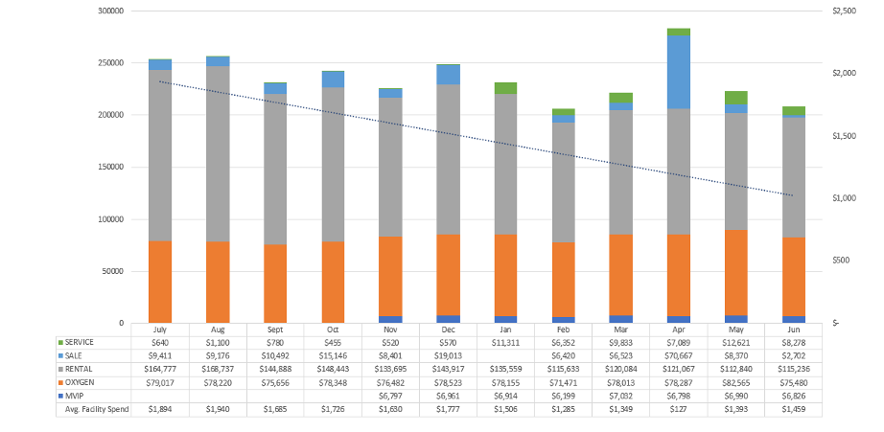
Year Review | Total Spend Summary

Slide 28
We Keep Healthcare Healthy™
We make medical equipment rental simple and facility hygiene better.

