Slide 1


Reduce Absenteeism
“Students who wash their hands at least 4 times a day will take 24% fewer sick days from colds and flu.”
Centers for Disease Control and Prevention

Slide 2

Healthcare
Keep staff and patients healthy
Eliminate spread of infection
Funding affected by infections
Hand hygiene is the number one way to stop the spread of infections
Mandatory Hand Hygiene Protocol
Schools
???
Keep students and faculty healthy
Eliminate the spread of flu and illness
Funding affected by illnesses
Hand hygiene is the number one way to stop the spread of illness

Slide 3
⅔ of US students missed school due to illness per CDC.
Many schools lose funding due to absenteeism linked to illness.
Infectious agents that children contract in schools result in infections of up to
Teacher illness costs the district thousands to millions of dollars.
50% of household members!
SYMMETRY HAND HYGIENE PROGRAM

Slide 4


Slide 5
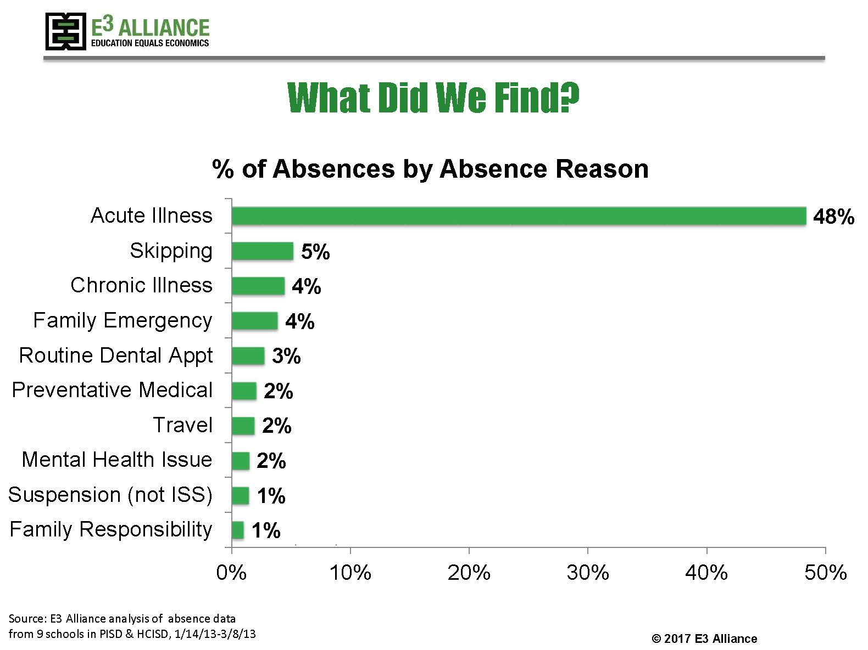

Slide 6
What can you do to
reduce absenteeism?
1
Provide effective
hand wash solutions
2
Educate on
proper procedures
3
Create awareness
SYMMETRY HAND HYGIENE PROGRAM

Slide 7
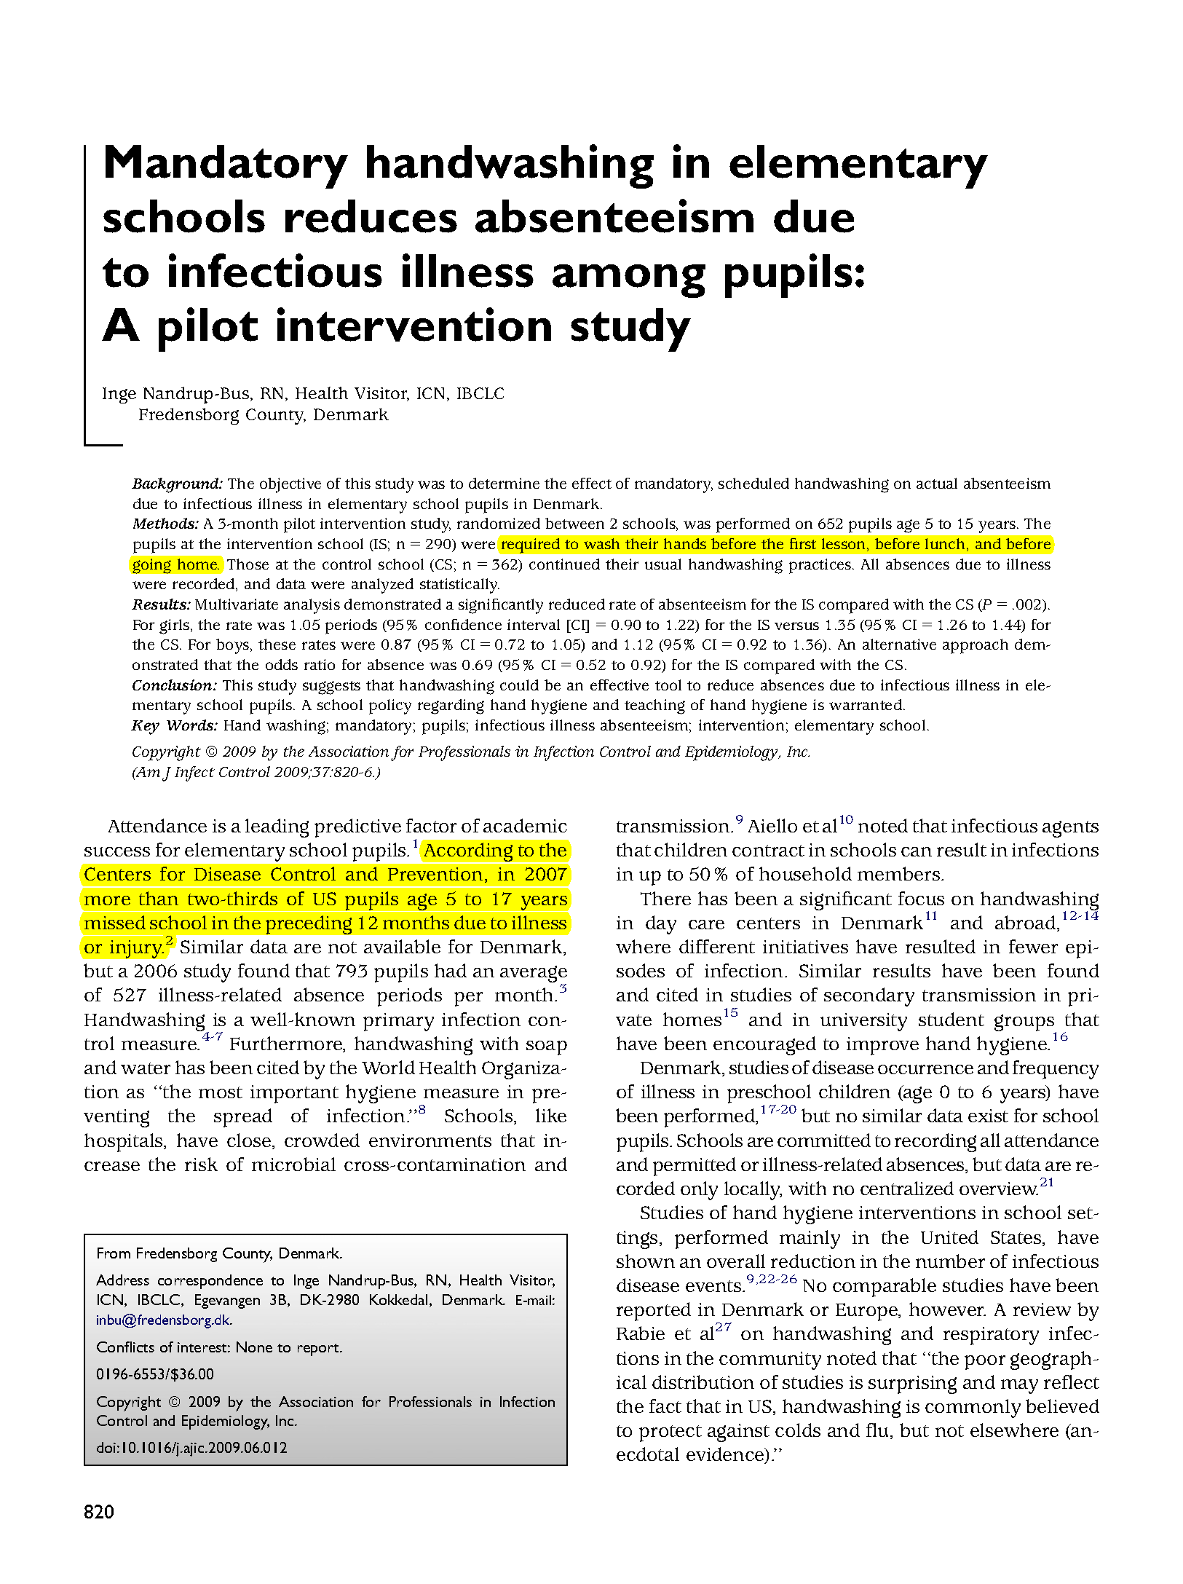
CASE STUDY
Mandatory hand washing in elementary schools required to wash 3 times per day
Before the first lesson
Before lunch
Before going home
Results:
20%
49%
Reduction in
respiratory illness
Reduction in
gastrointestinal illnesses

Slide 8
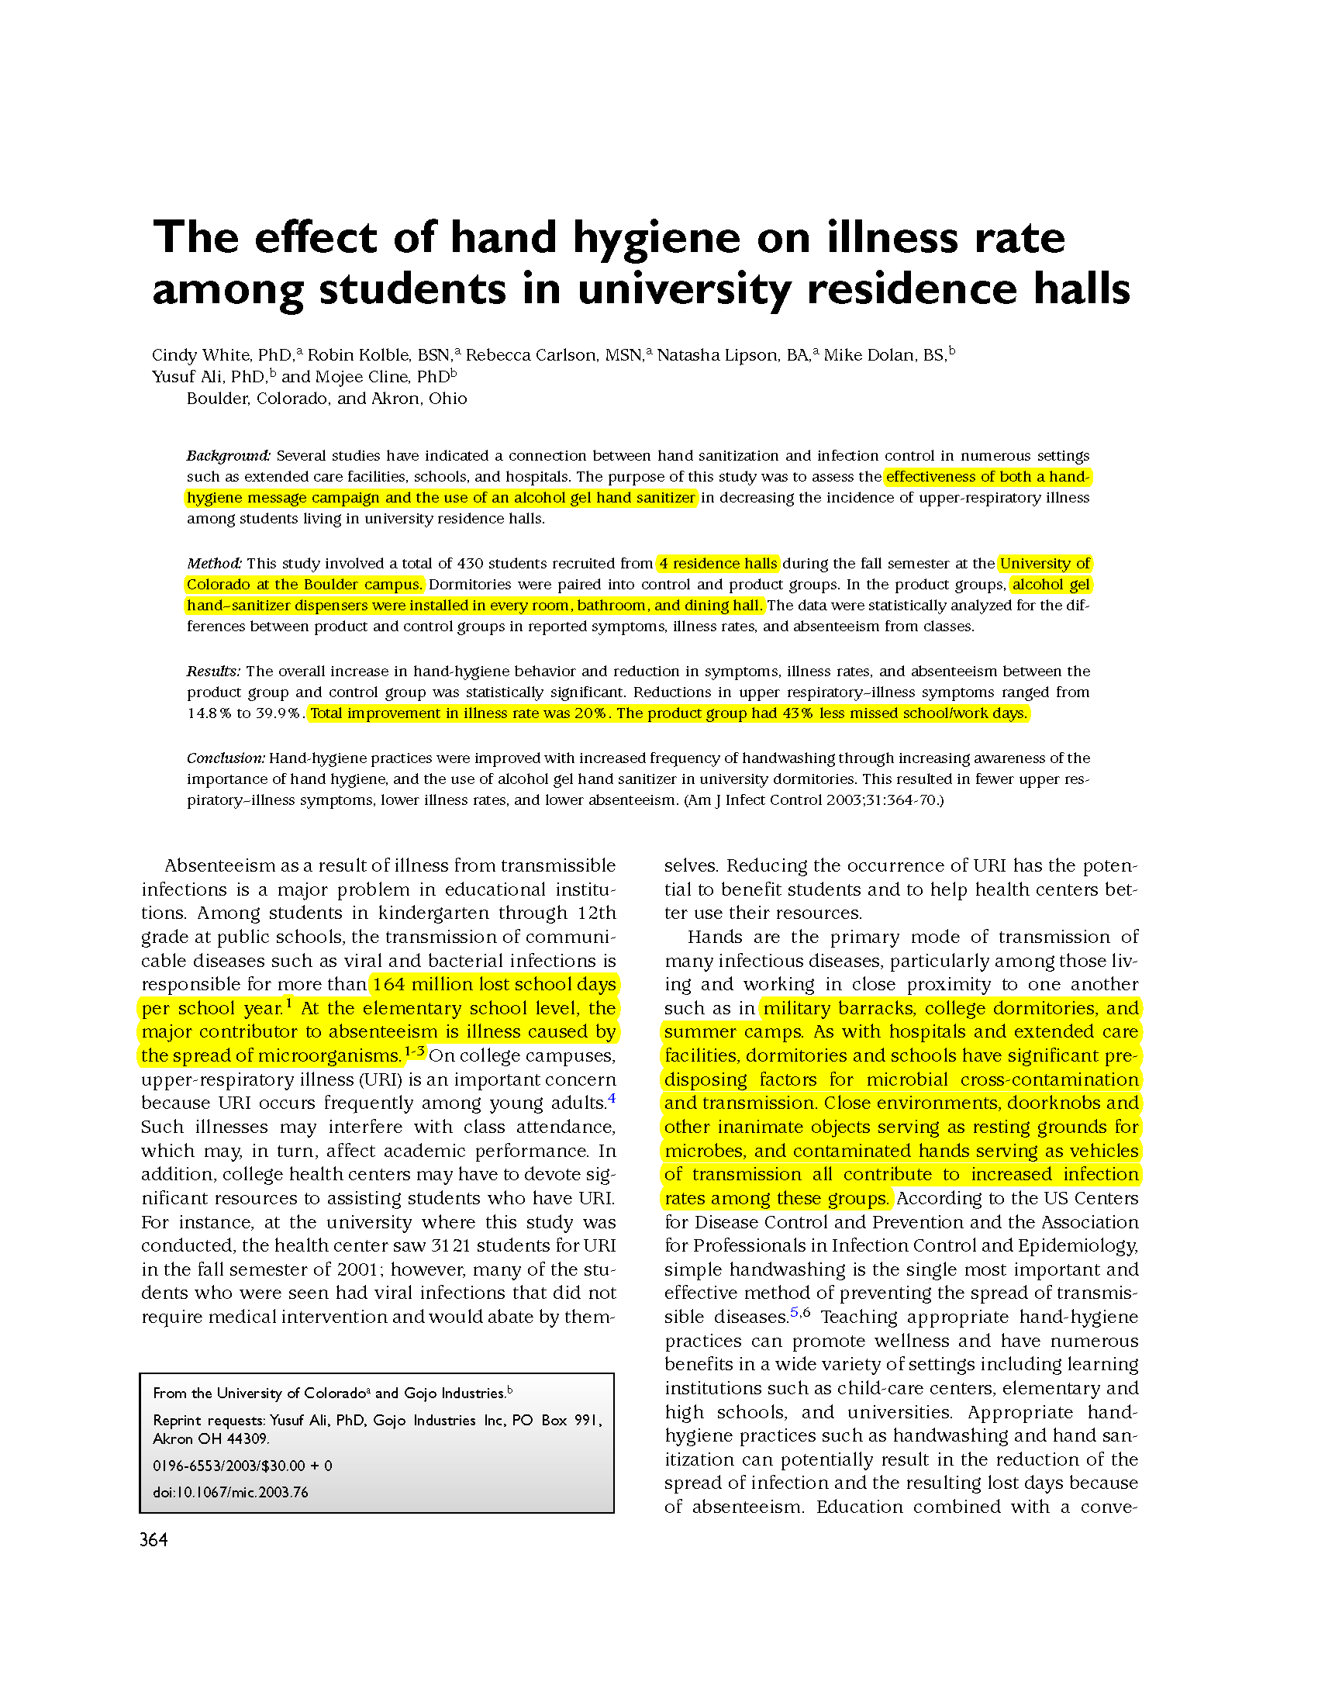
CASE STUDY
Effectiveness of Hand Hygiene Message Campaign:
Purpose of study:
Assess the effectiveness of both a hygiene message campaign and the use of an alcohol gel hand sanitizer
Method:
430
University students from 4 residence halls recruited for the study
Alcohol gel hand sanitizers were installed in every room, bathroom, and dining hall
Results:
20%
43%
Total improvement
in illness rate
Less missed school/work
days by participants

Slide 9
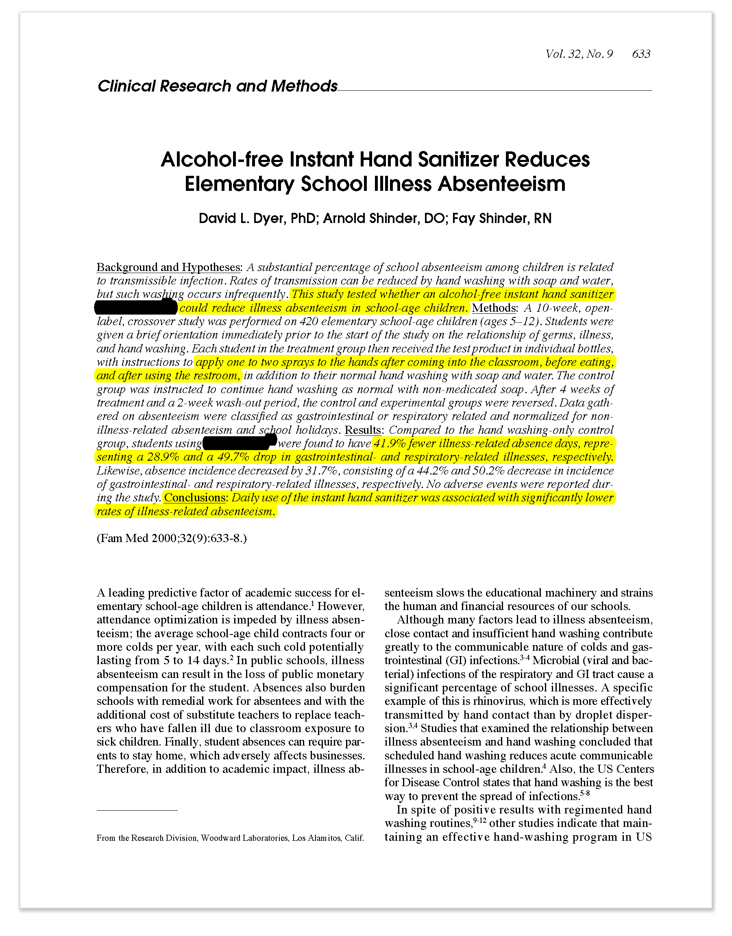
CASE STUDY
Purpose :
Tested whether an alcohol-free instant hand sanitizer could reduce illness absenteeism in school-age children.
Results:
Students who used hand sanitizer regularly in addition to normal handwashing had
49%
fewer illness-related absence days
29%
less gastrointestinal-related illnesses
50%
less respiratory-related illnesses

Slide 10
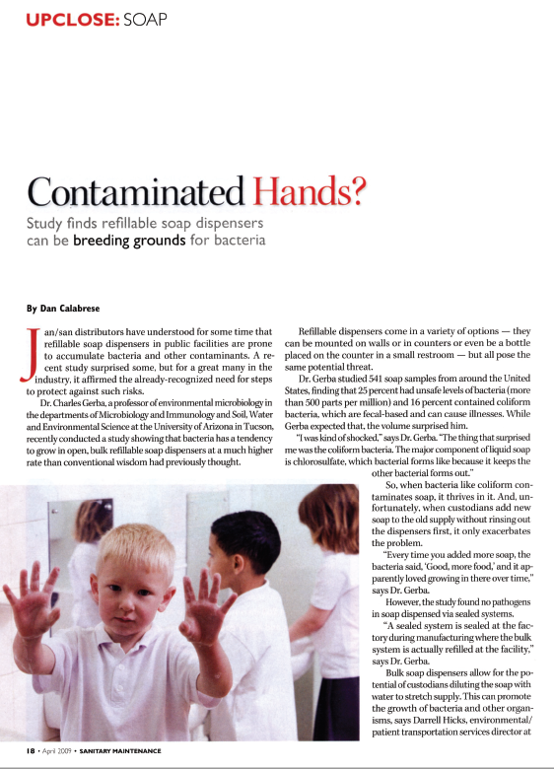
BULK SOAP CONTAMINATION STUDY
Hot Topics
Study conducted by :
Dr. Charles Gerba – Professor of Environmental Microbiology at the University of Arizona
Findings from study:
Out of
541
Soap samples from around the U.S.
25%
16%
Had unsafe levels of bacteria
Contained coliform bacteria, which are fecal based and can cause illness

Slide 11
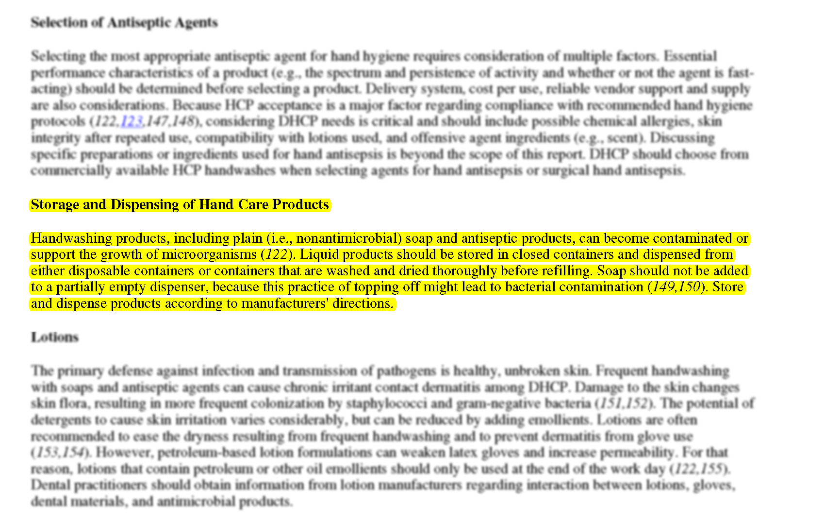
Cdc on bulk

Slide 12

SYMMETRY HAND HYGIENE PROGRAM

Slide 13
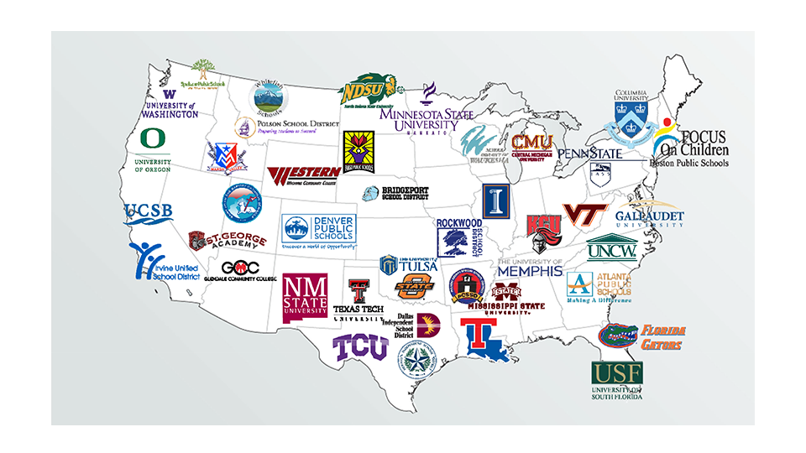

Slide 14

Provide high quality
and low cost products
Efficacy of the products
Implement tools to
Increase education and awareness
Implement behavior modification tools to increase hand hygiene practice
SYMMETRY HAND HYGIENE PROGRAM

Slide 15
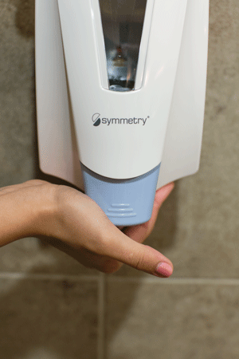
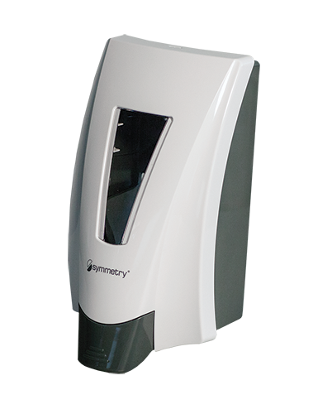
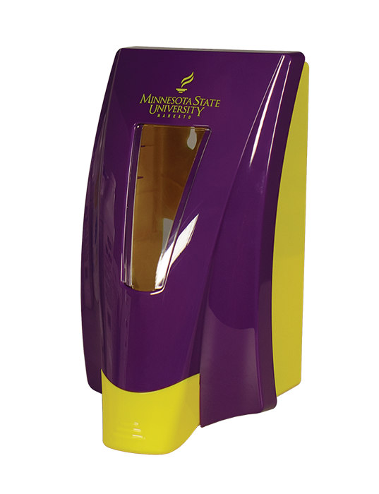
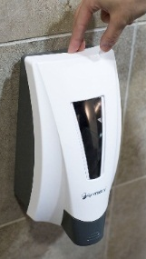
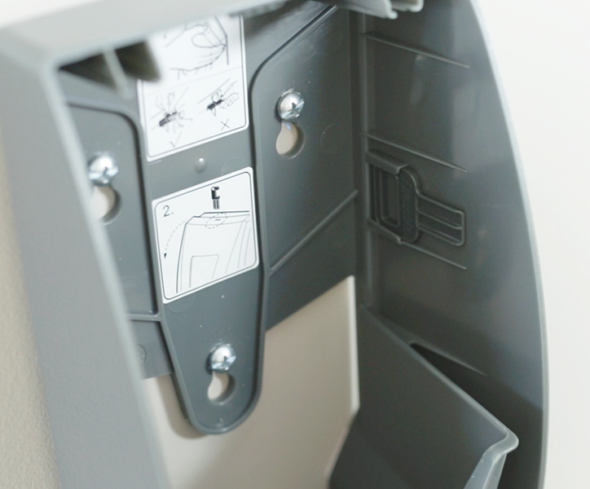
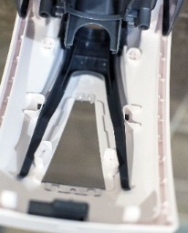
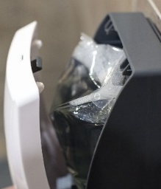
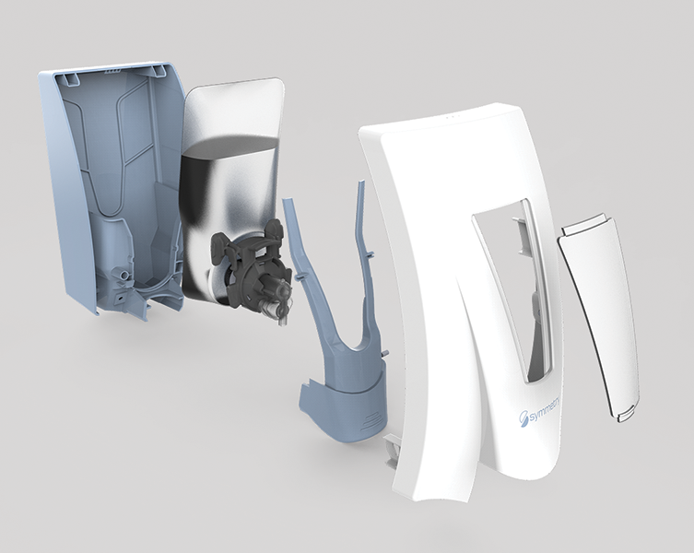
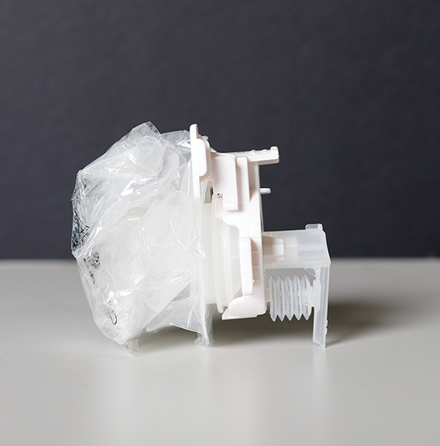
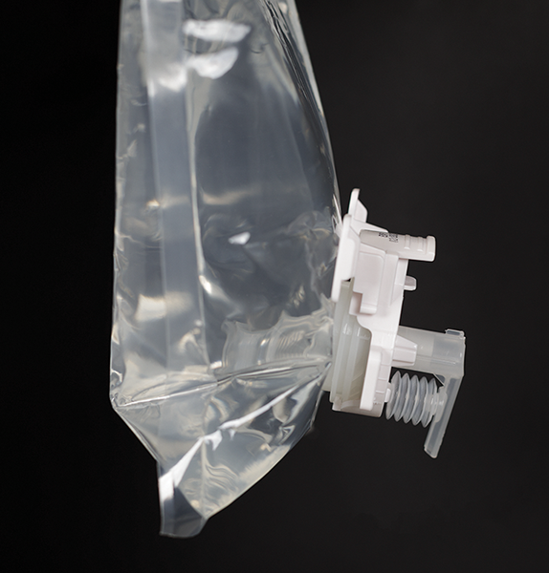
DISPENSER FEATURES
key
1. User Driven Design
180° Accessible Lever
2. Large Sight Window
Visibility of product level
aids in ensuring product is always
available
3. Customization
Logo
Message
Color
4. User Designated Lock
Hidden lock or Keyed
5. Optimal Durability
Interlocking Ribs
Anti-Vandalism Posts
6. Repair-in-Place Technology
Easy to get back in operation
7. Flexible Packaging
More environmentally friendly
than aerosol can & ridged container
99% evacuation
8. Patented No-Drip
Bellow System

Slide 16
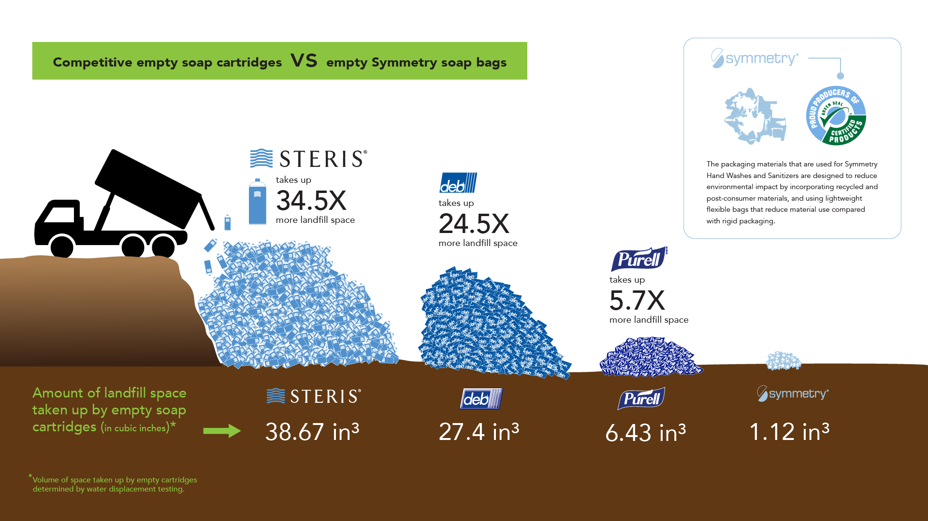

Slide 17
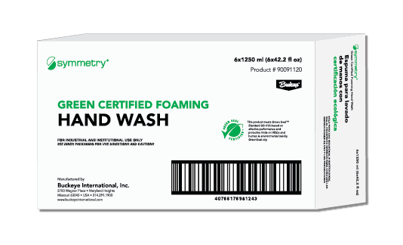
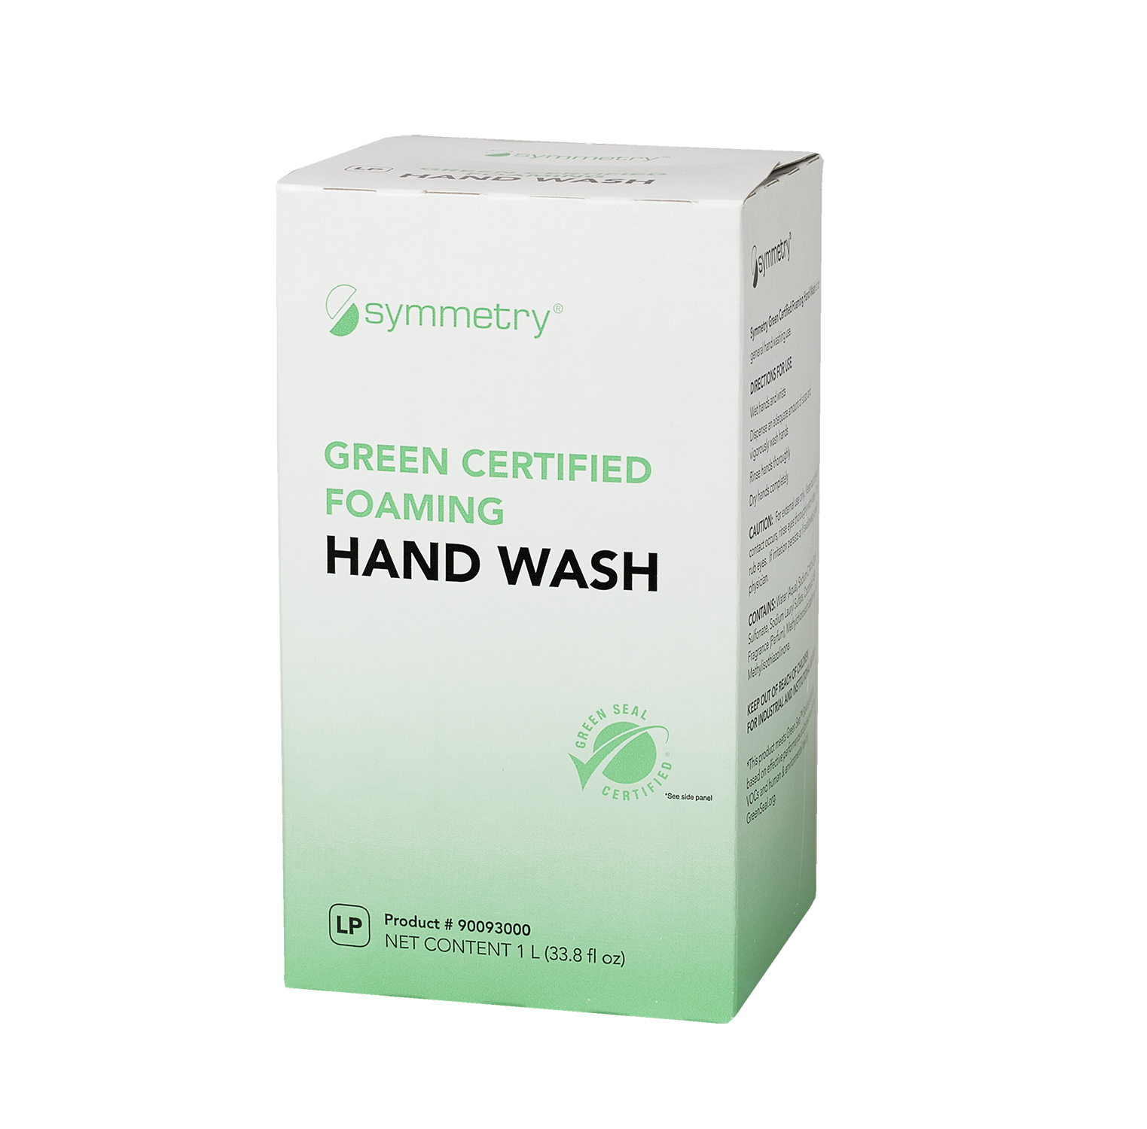
SUSTAINABILITY
Packaging
Symmetry Outer Box Packaging
Symmetry Inner Carton Packaging
One ton of paper from recycled pulp saves:
17
4,200
(enough to heat a home for 6 months)
3
cubic yards
130 tons (261,233 lbs) of recycled content
41% recycled material
96.6 tons (193,224 lbs) of paper diverted from the landfill
35% minimum post-consumer material diverted from the waste stream at the end of its intended lifecycle
390
7,000
gallons of
2,220 trees saved
Recycling 1 ton of cardboard saves over nine cubic yards of landfill space
1,175 cubic yards of landfill space
Over the past year, based on this recycling information, Symmetry:
50,934 gallons of oil
7,836 pounds of air pollutants
Saved enough energy to heat 276 average sized US homes for a year
Reduced air pollution equivalent to removing 1,656 18-wheelers from the road
Reduced emissions of greenhouse gases equivalent to removing 14,904 automobiles from the road
Prevented the production of 1,932 Olympic-sized swimming pools worth of waste water
https://www.rpa100.com/why/benefits/
https://bit.ly/2Gi08qo
All Symmetry products are triclosan-free
The US Food and Drug Administration (FDA) has finalized a rule that bans the making of over-the-counter (OTC) healthcare antiseptic products containing triclosan.

Slide 18
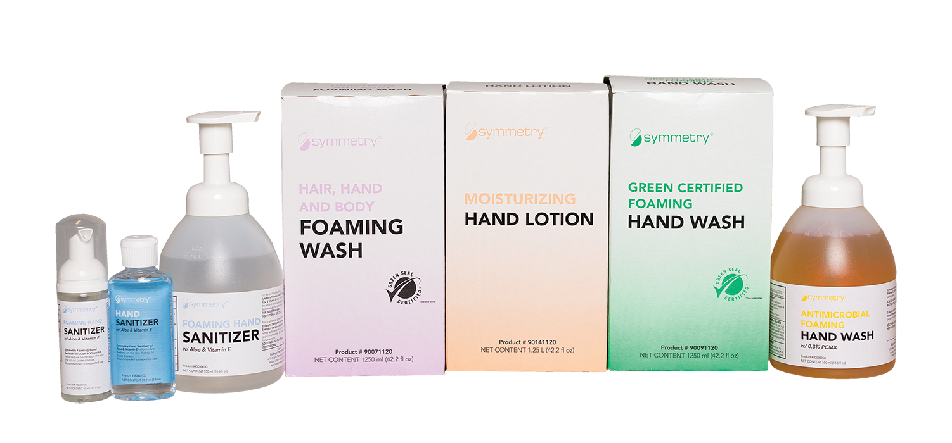

Symmetry products
Hand Wash Products †
Green Certified Foaming Hand Wash*
Green Certified Foaming Hand Wash Unscented*
Antimicrobial Foaming Hand Wash
with 0.3% PCMX
Hair, Hand and Body Foaming Wash*
Hand Care Products
Moisturizing Hand Lotion
For Skin Conditioning
Hand Sanitizers
Non-Alcohol Foaming Hand Sanitizer
With Aloe & Vitamin E
Foaming Hand Sanitizer †
With Aloe & Vitamin E
Foaming Hand Sanitizer Fragrance Free
With Aloe & Vitamin E
† Also available in gel
Please note: No Symmetry products contain Triclosan
*
This product meets Green Seal® Standard GS-41A based on effective performance and protective limits on VOCs and human & environmental toxicity. GreenSeal.org.

Slide 19
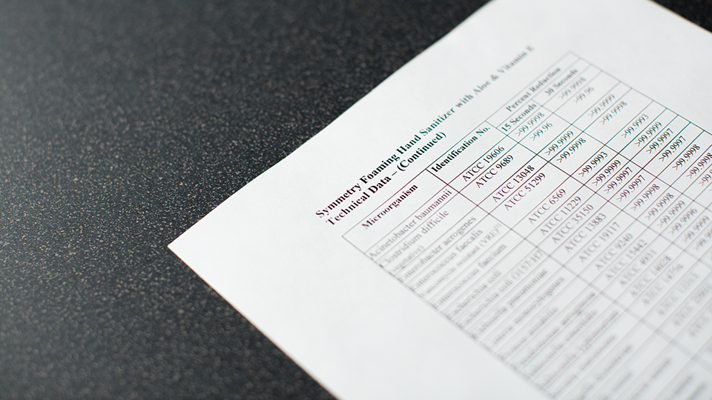
Formulations follow the FDA’s TFM
Extensive irritation & sensitivity testing
Benchmarked efficacy standards

Slide 20
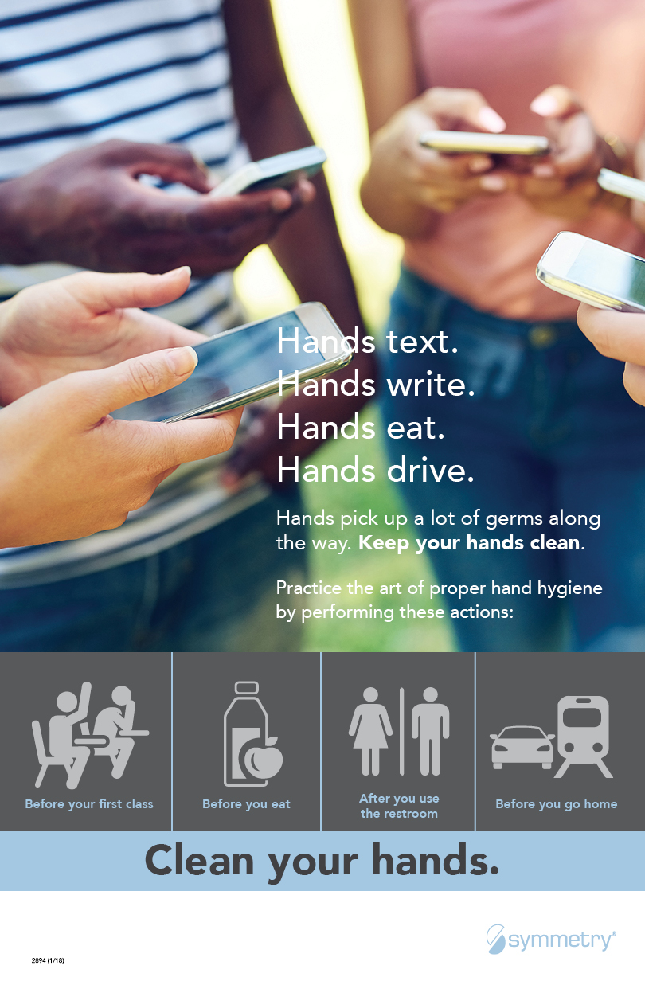

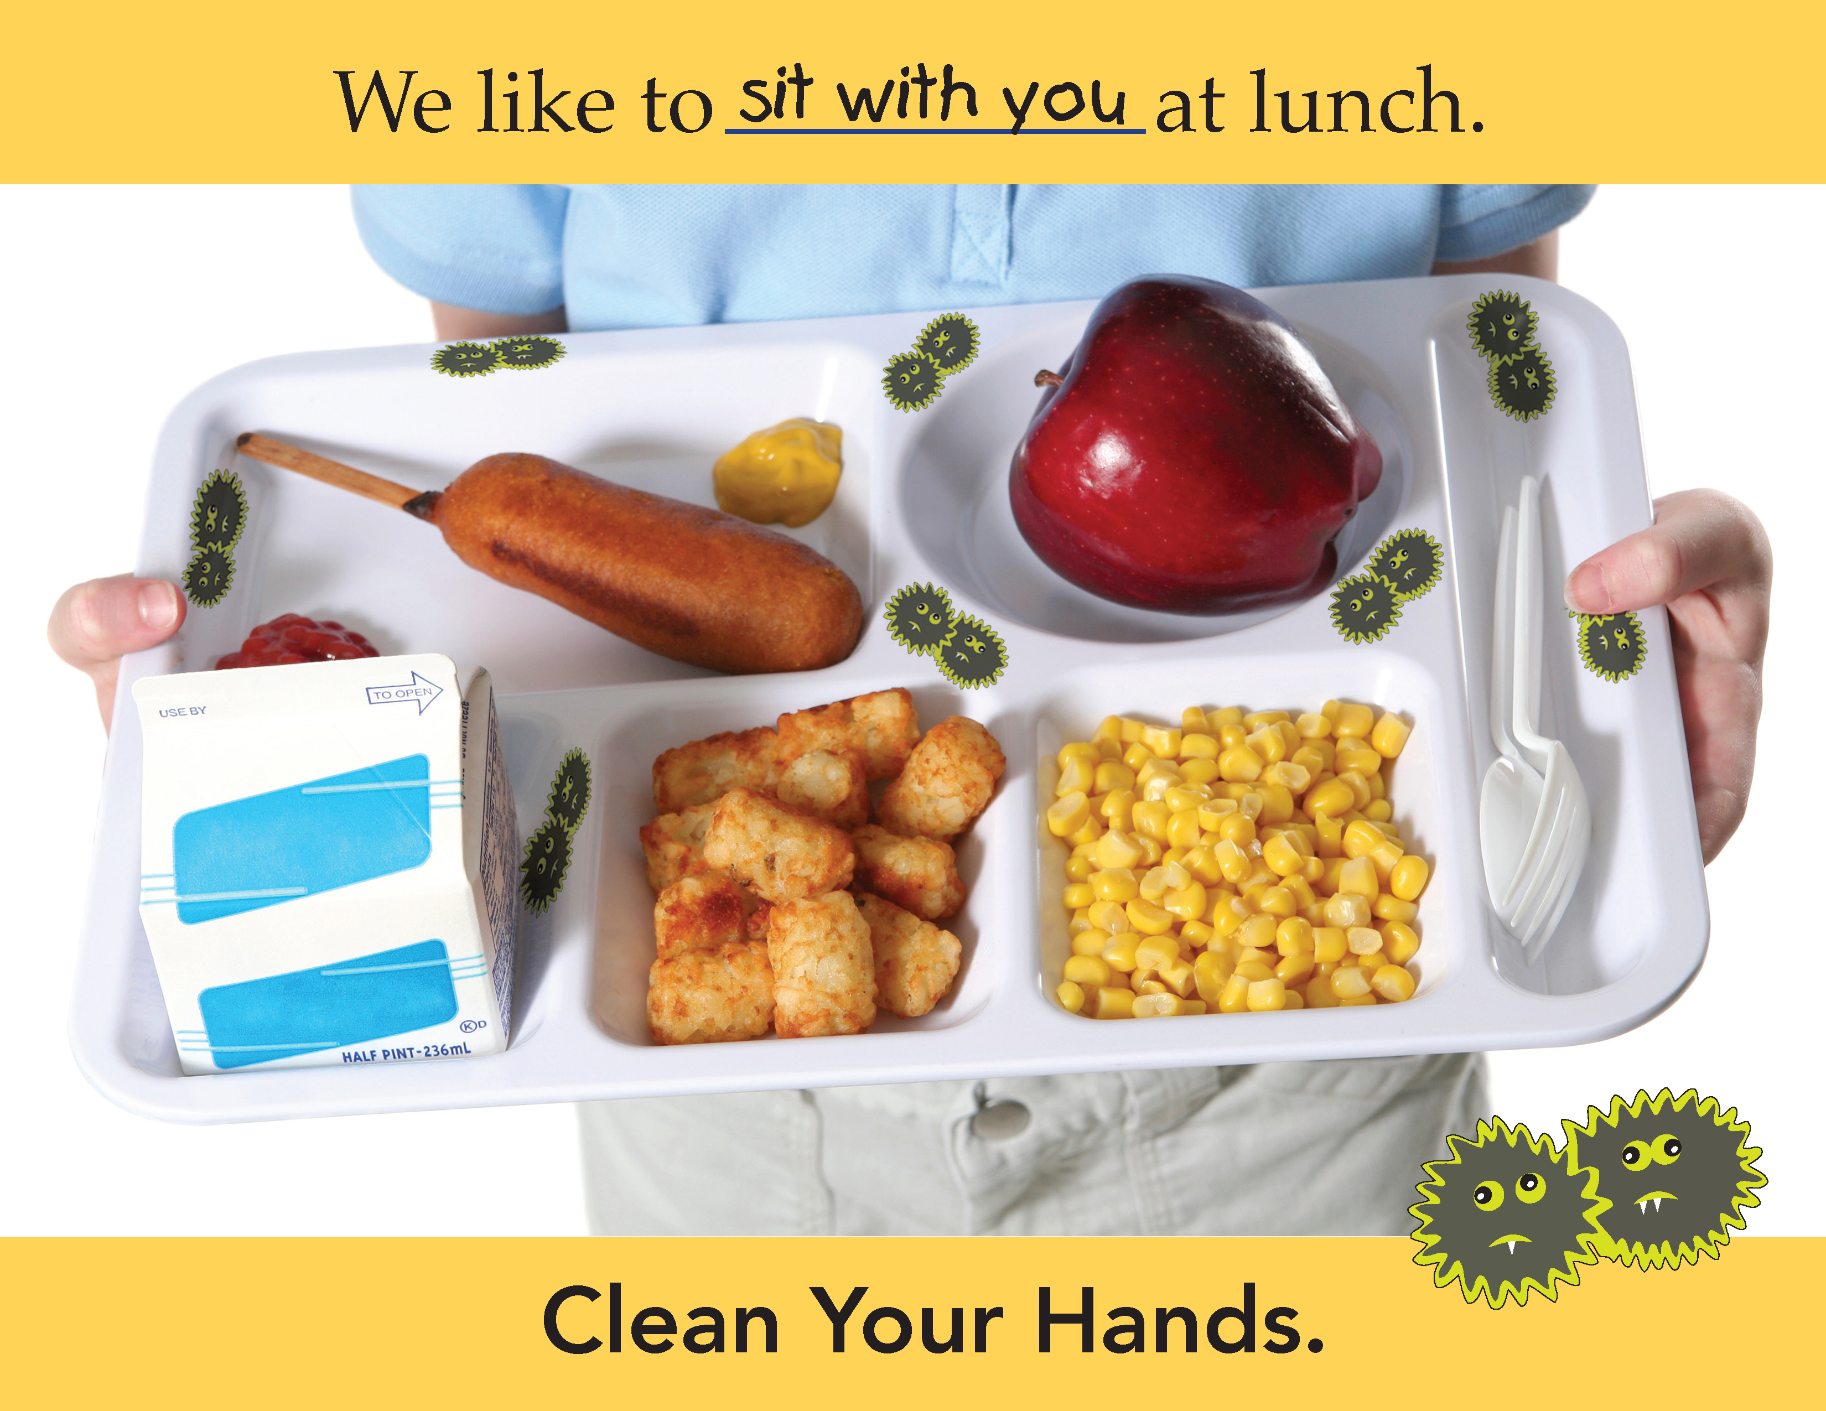
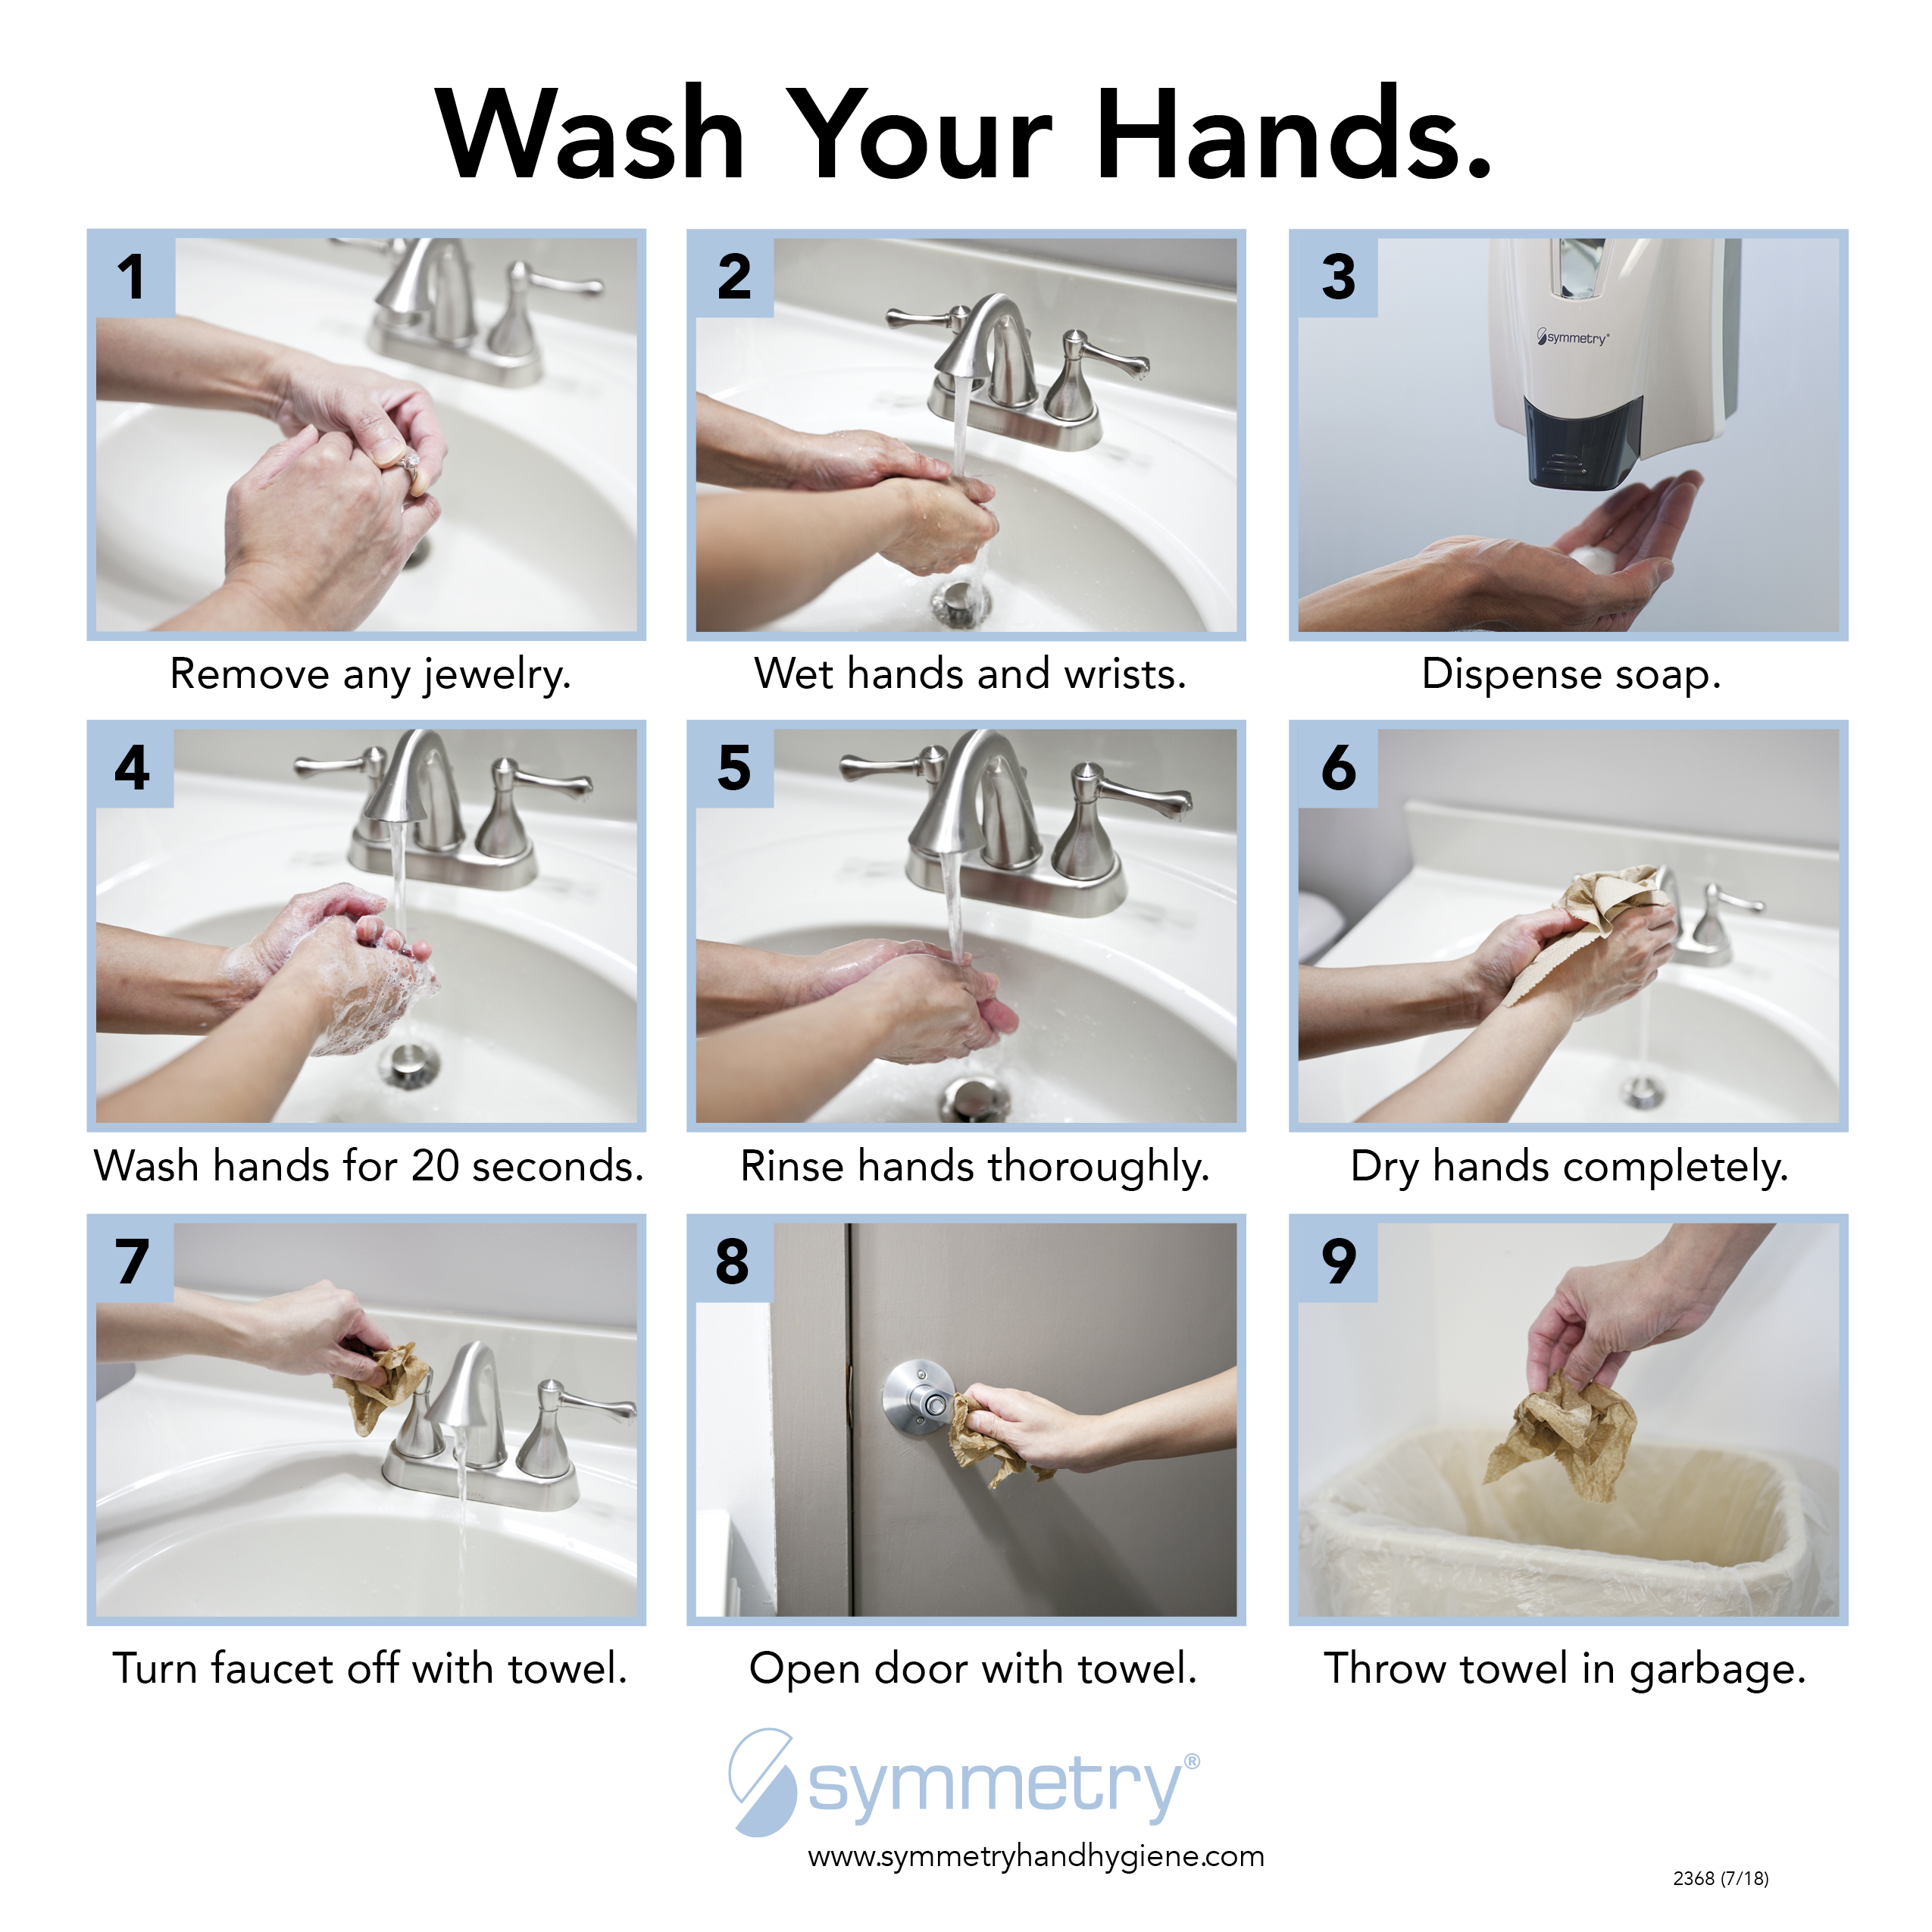
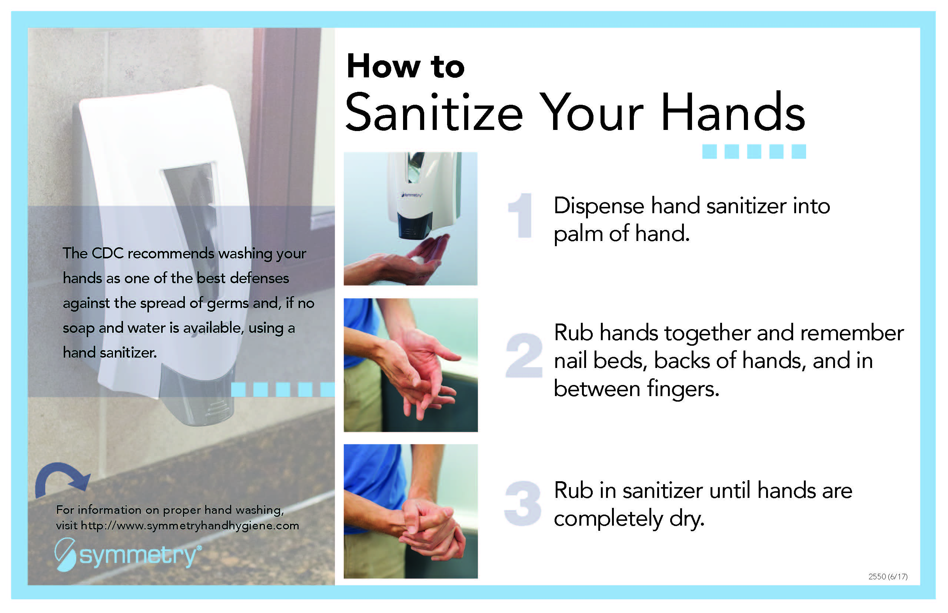
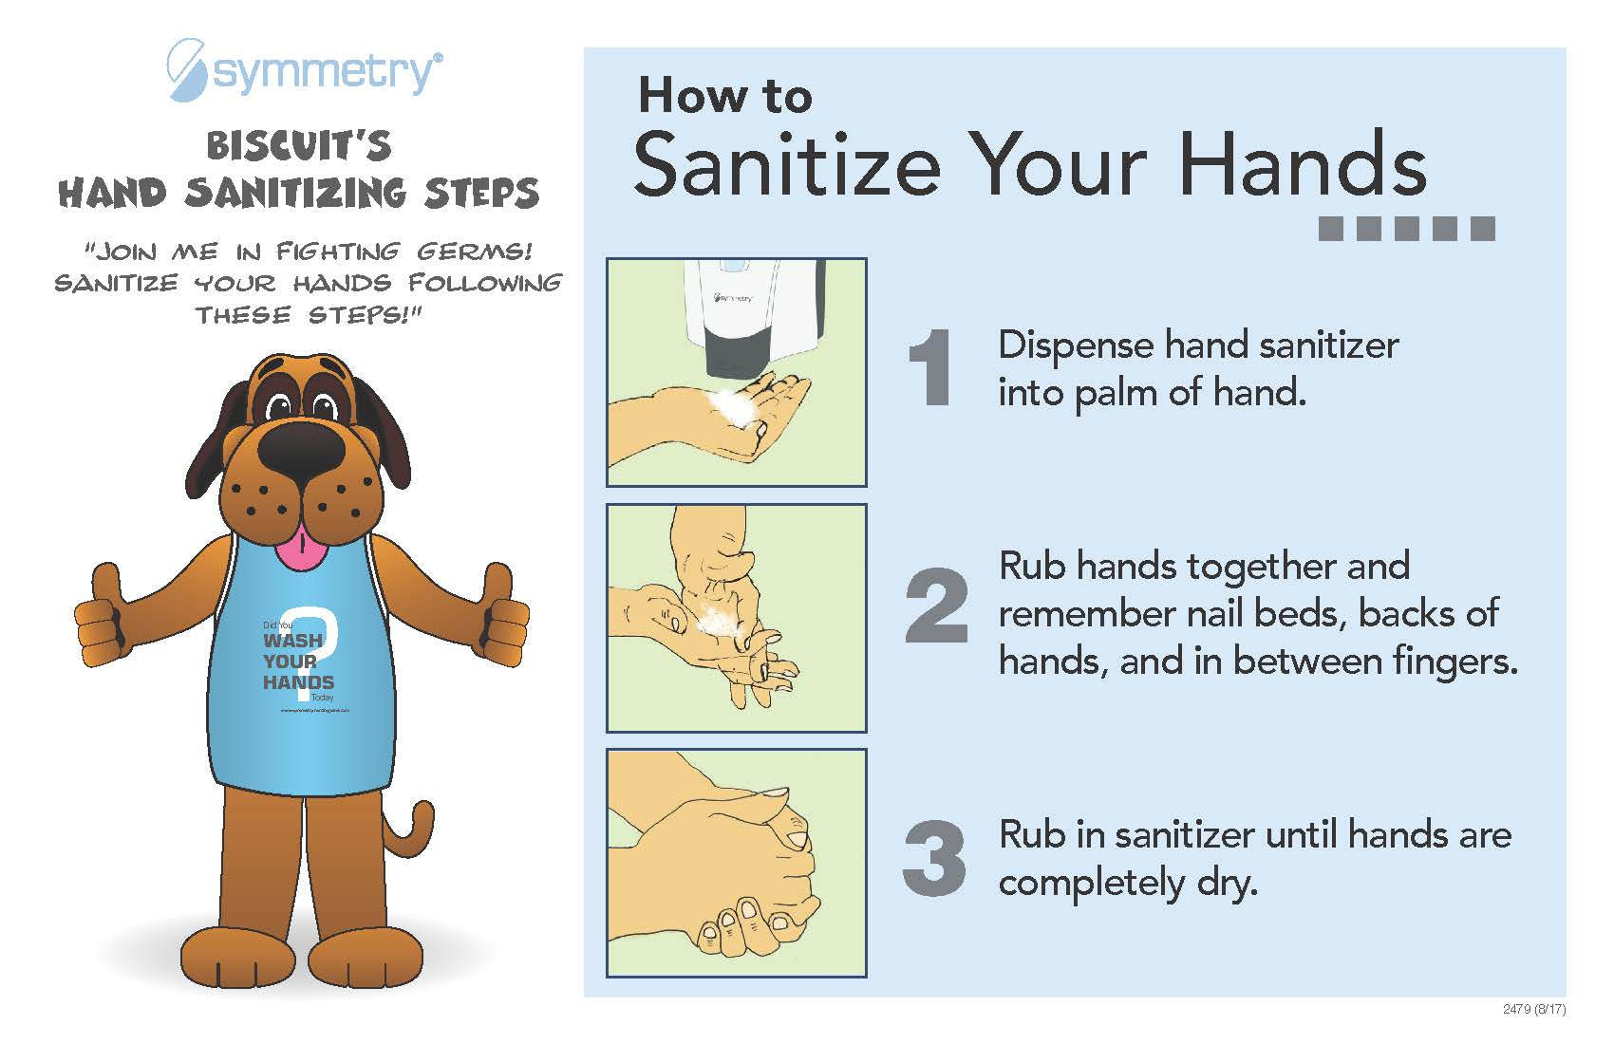
Education and awareness materials

Slide 21
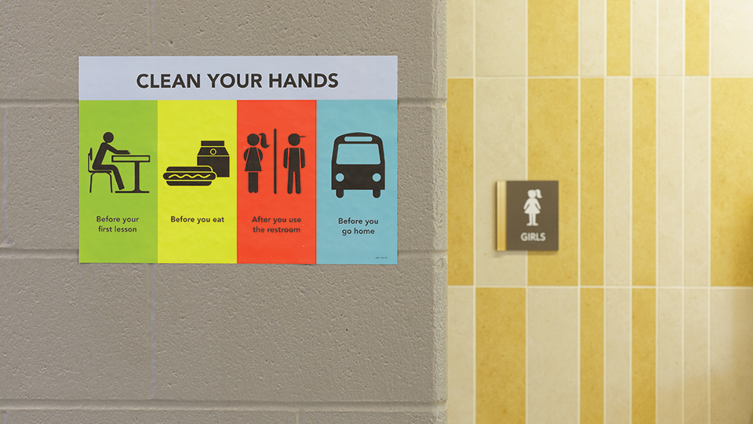
4 Key Times to Perform Hand Hygiene

Slide 22
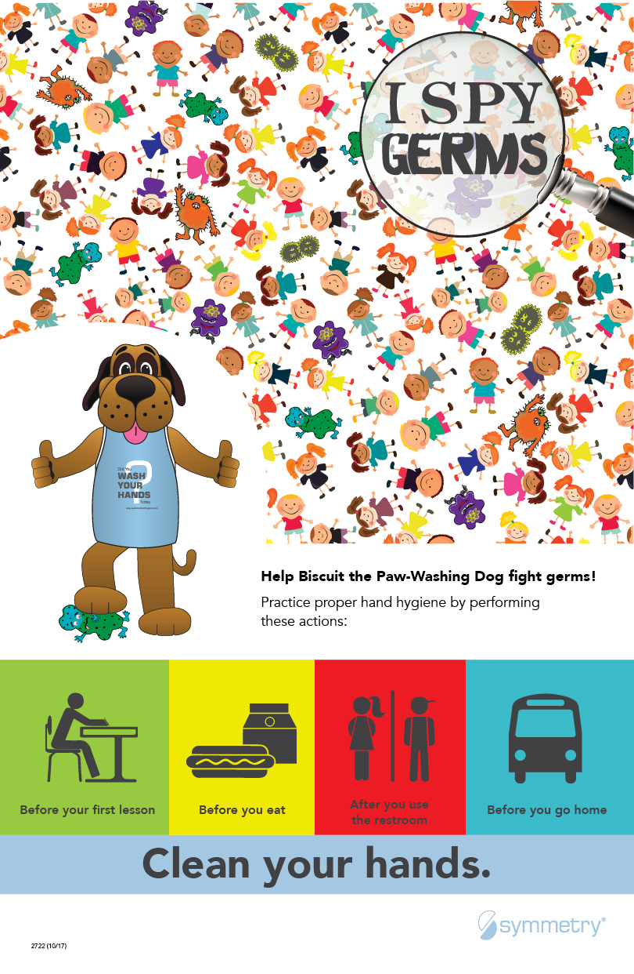
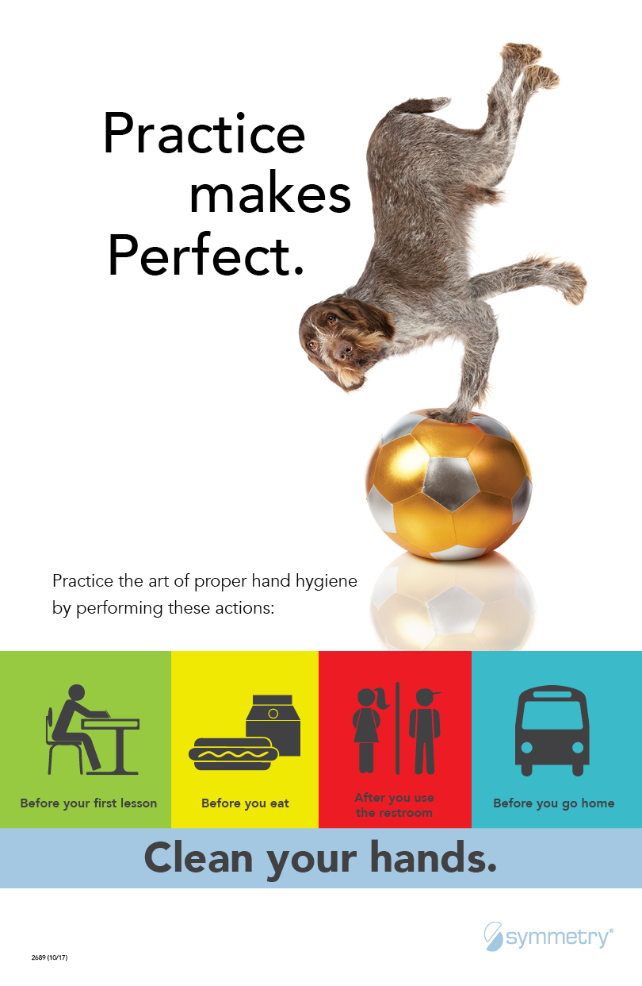
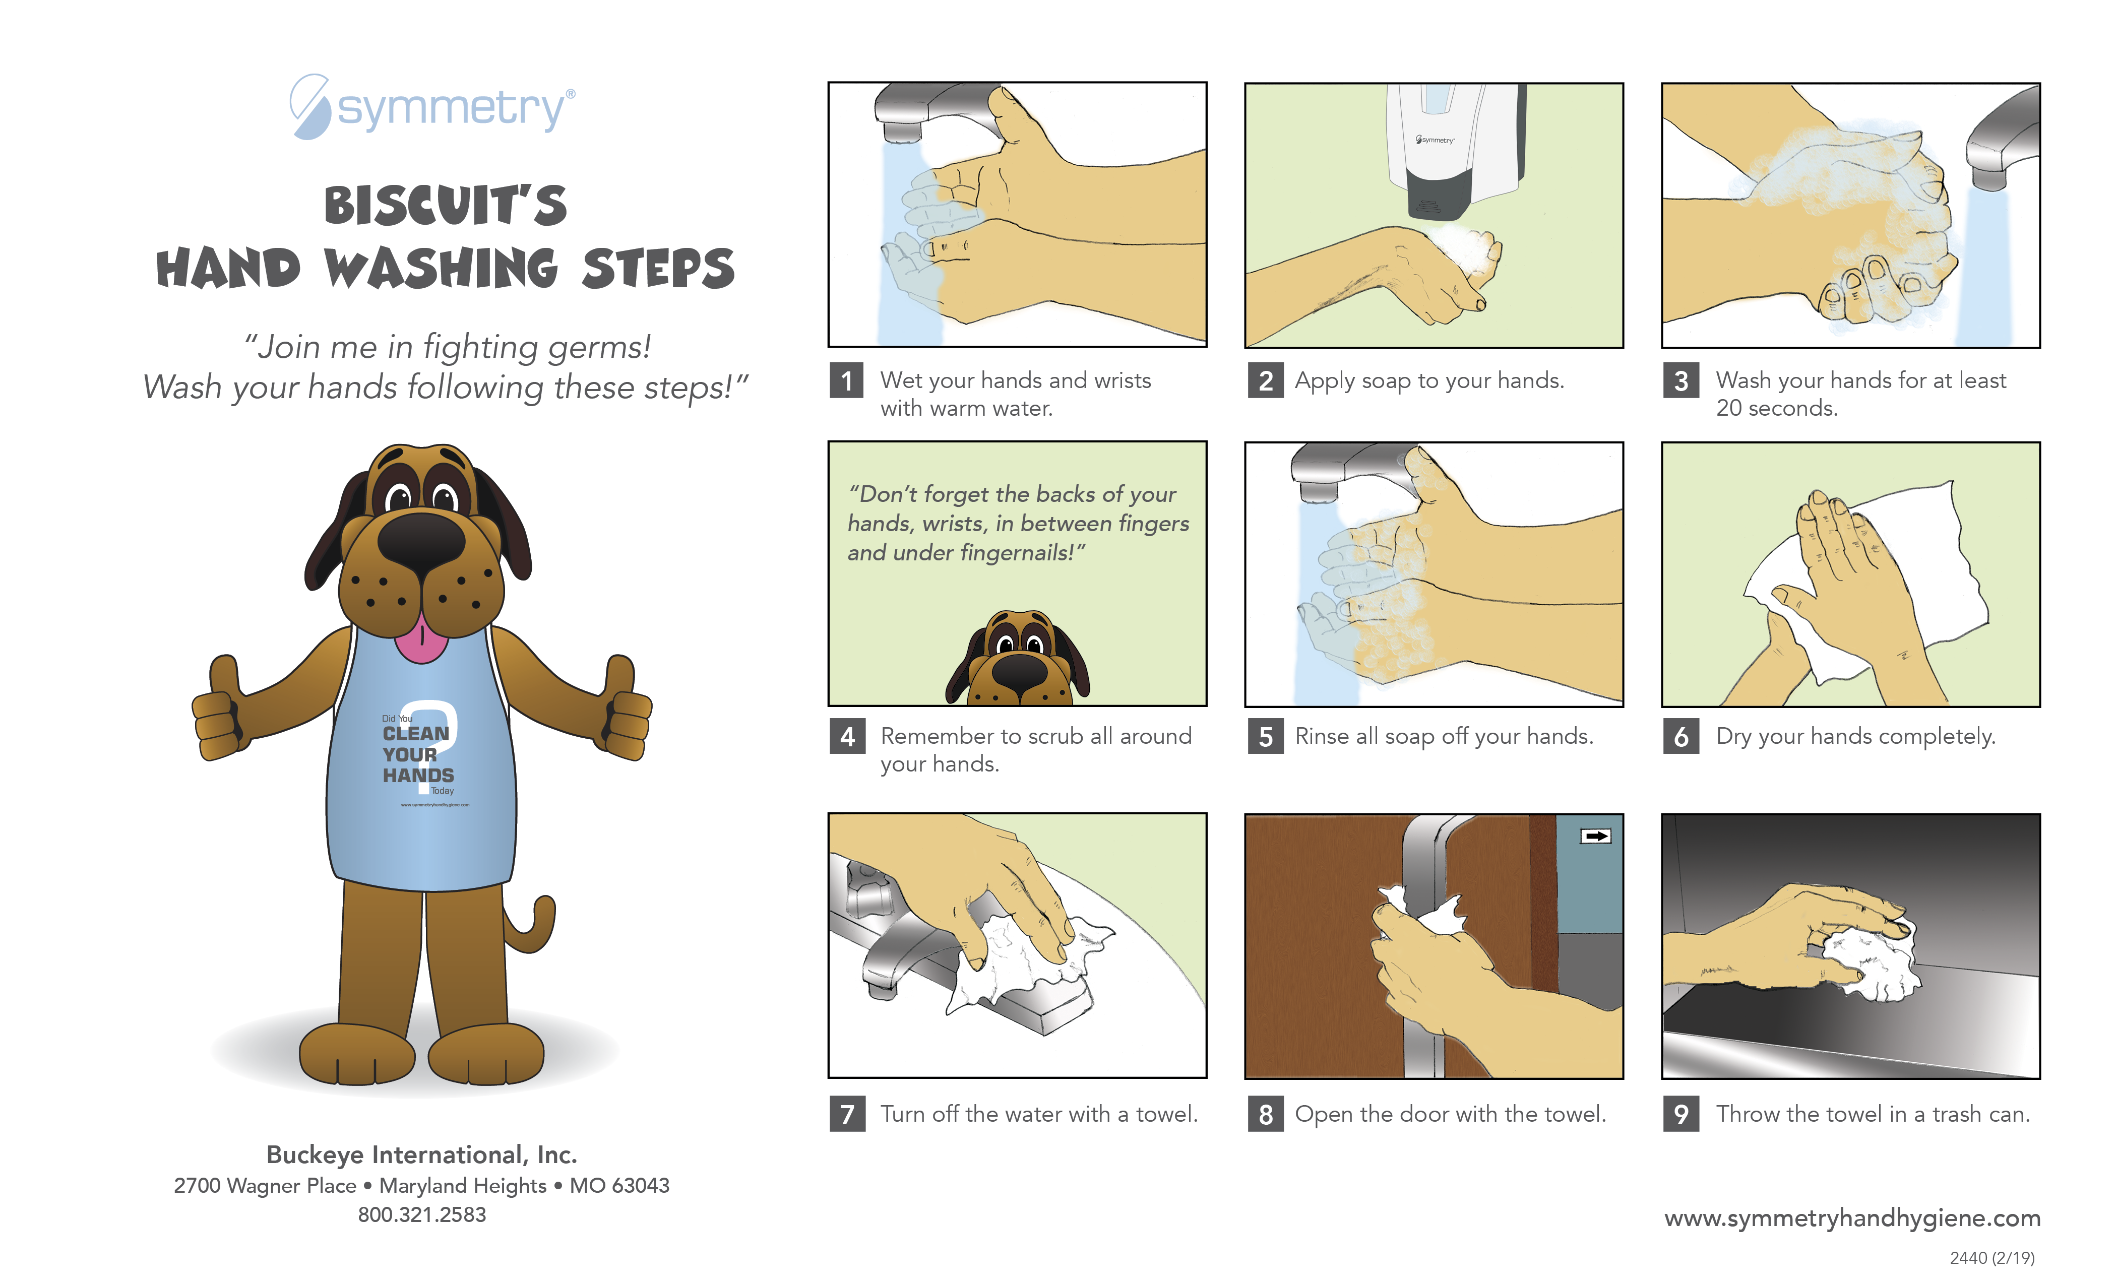
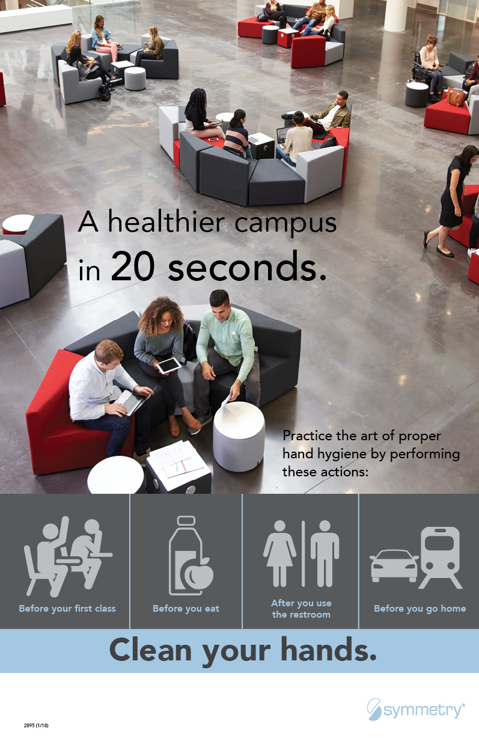
Education and awareness materials
K – 3rd Grade
4th – 8th Grade
9th – 12th Grade

Slide 23
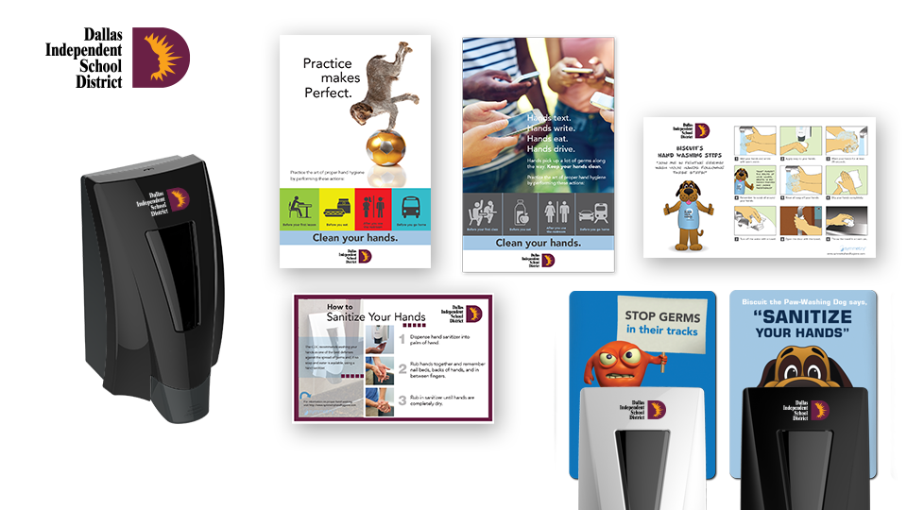
SYMMETRY CUSTOM PROGRAMS

Slide 24

Symmetry hand hygiene mascot
Biscuit the Paw Washing Dog
Fun, engaging and educational, helping elementary students develop lifelong hand hygiene practices
Interactive videos and prizes
Facts about germs and proper hand washing/sanitizing steps

Slide 25


Symmetry hand hygiene assemblies
with Biscuit the Paw Washing Dog

Slide 26
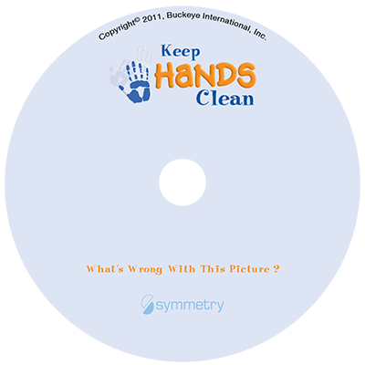
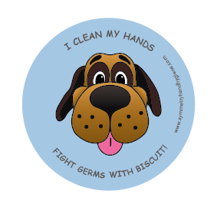
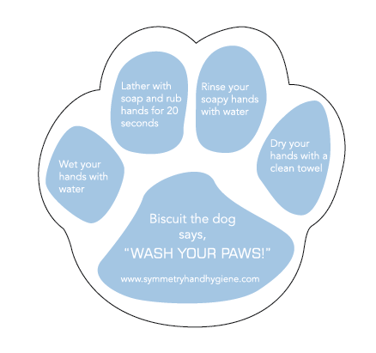
Biscuit-themed education and
Awareness materials

Slide 27

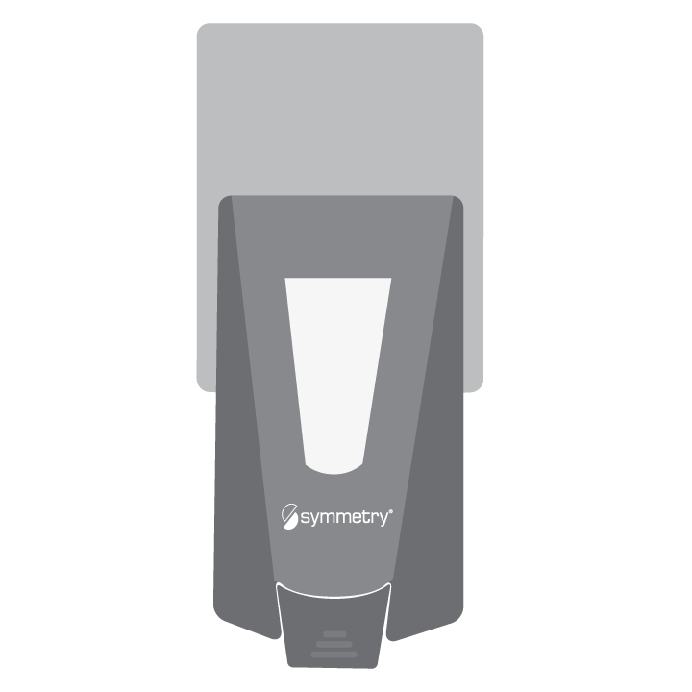





SBMS
Behavioral Science
Benevolence – desire to do good to others; goodwill; charitableness.
Accountability – an obligation or willingness to accept responsibility or to
account for one's actions.
Responsibility – a moral obligation to behave correctly toward or in respect of.
Variation – a change or difference in condition, amount, or level, typically with certain limits.
Emotion – a natural instinctive state of mind deriving from one’s circumstances, mood or relationships with others.
Direction – an explicit instruction.
We utilize behavioral science to drive hand hygiene compliance

Slide 28
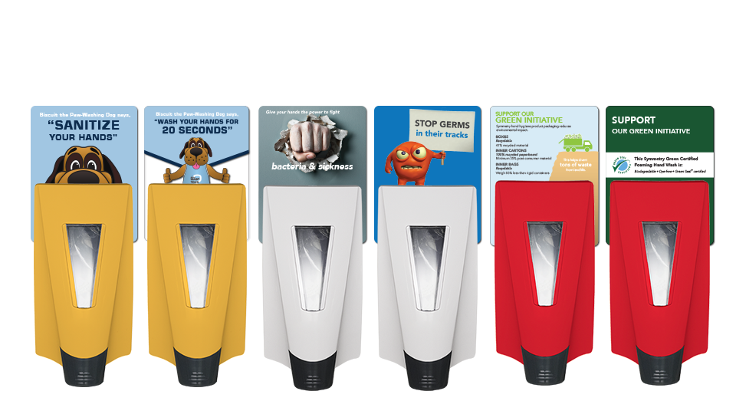
Behavioral modification placards
K – 3rd Grade
4th – 8th Grade
9th – 12th Grade

Slide 29
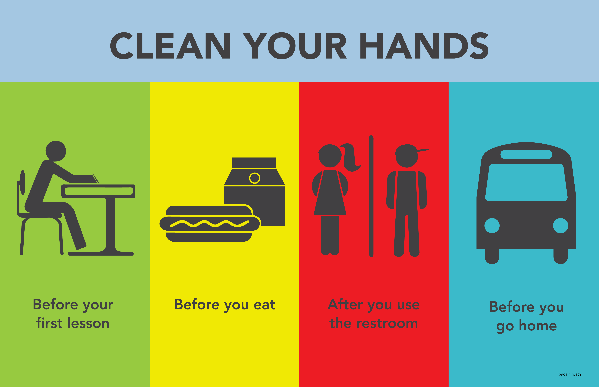
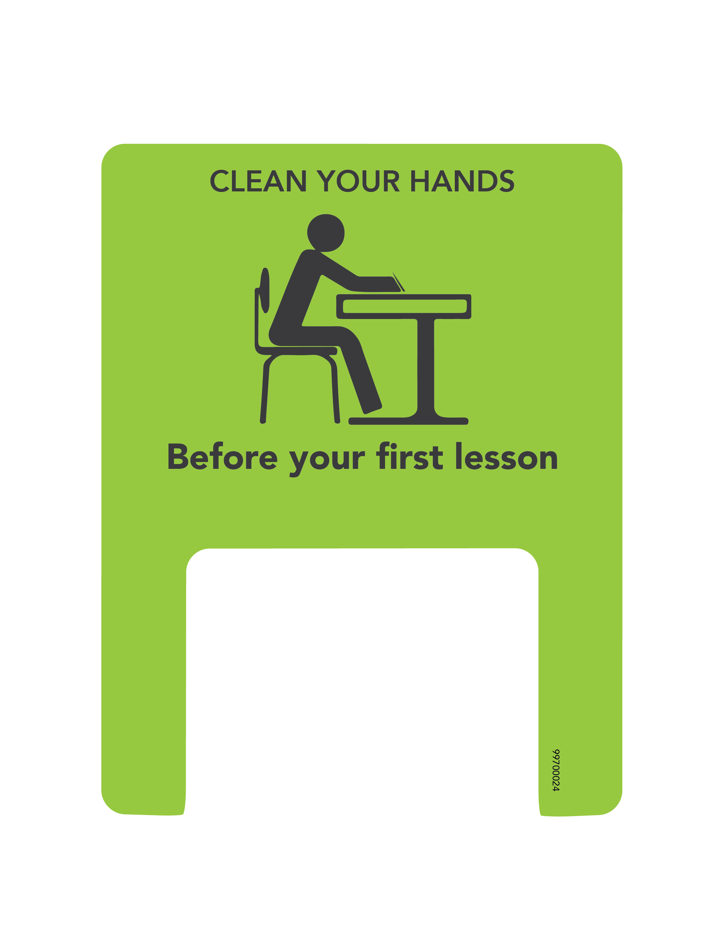
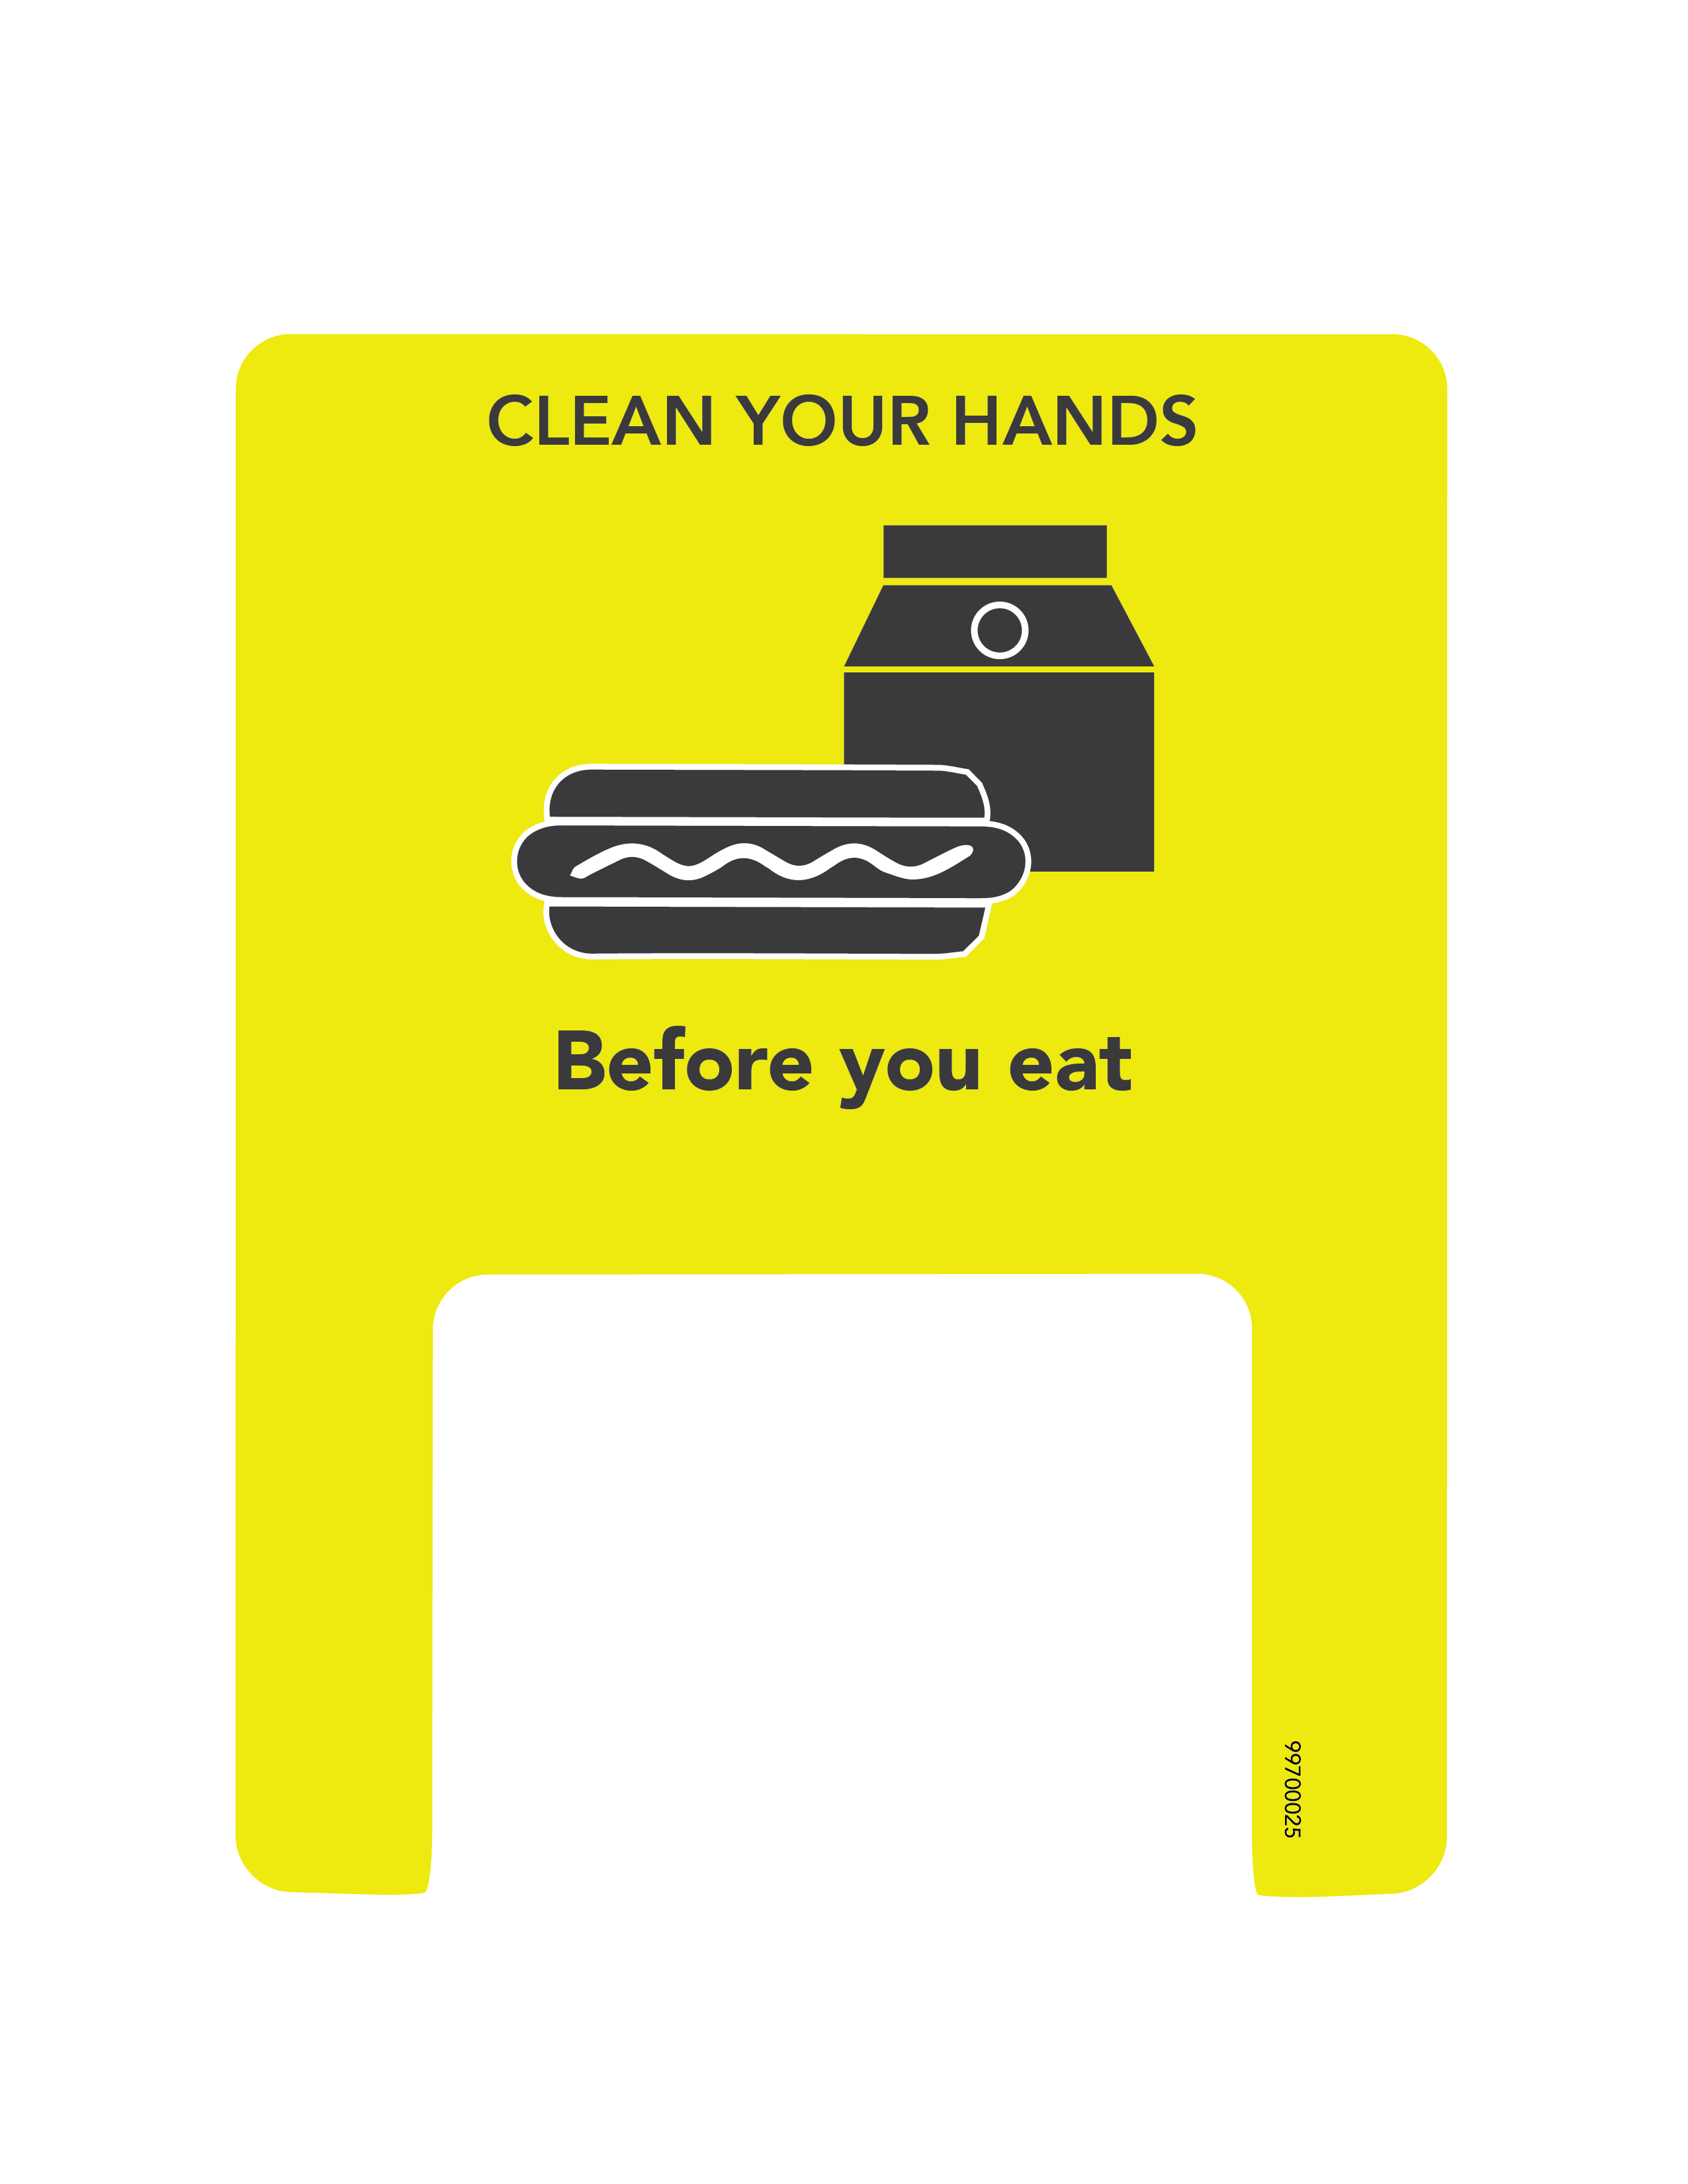
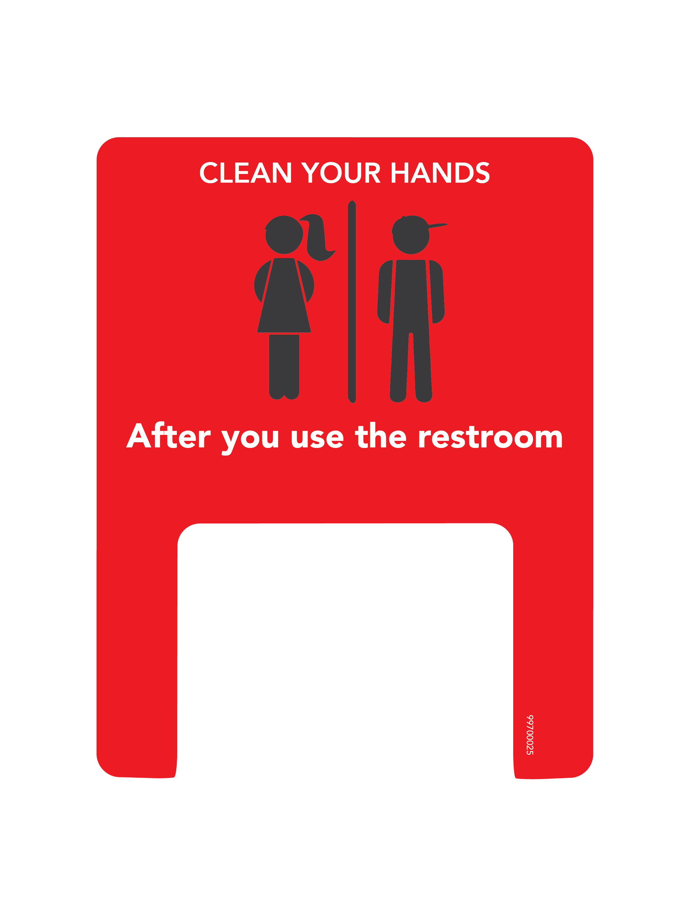
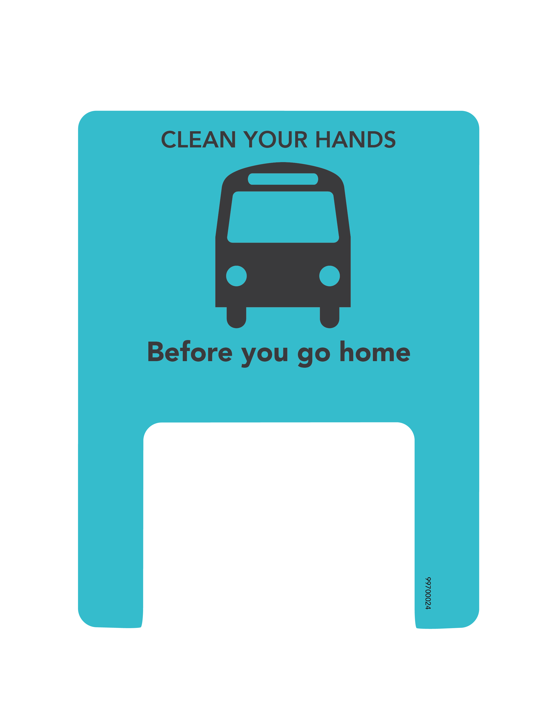

Slide 30
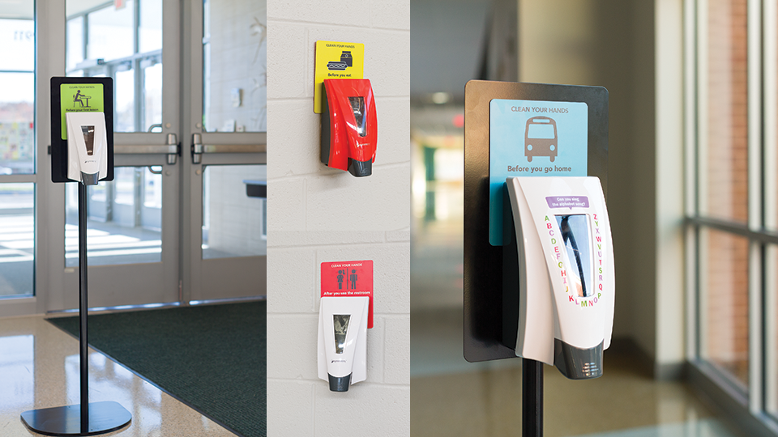
KEY LOCATIONS TO POSITION SANITIZING STANDS

Slide 31
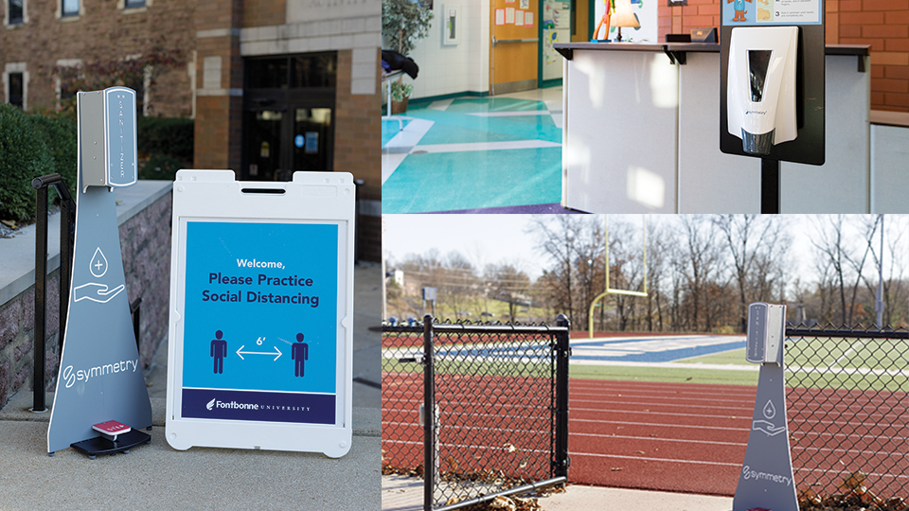

Slide 32
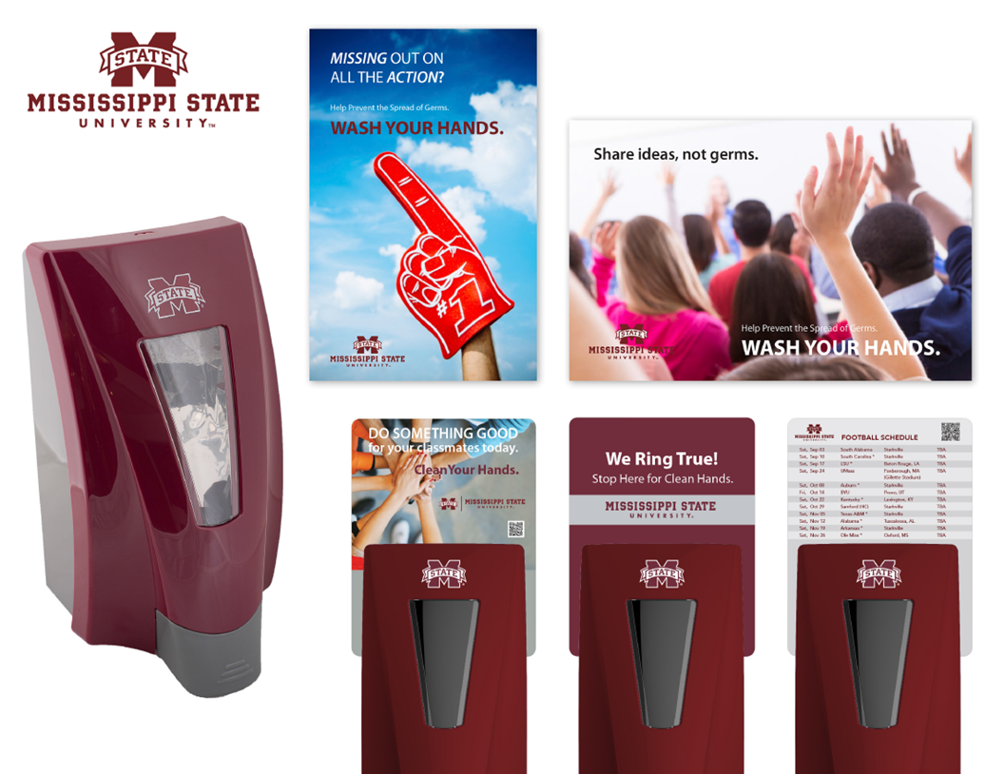
COLLEGE AND UNIVERSITIES

Slide 33



Guidance from the CDC on Reopening Schools
The CDC has released guidance for reopening K-12 schools safely and as soon as possible so students have access to the benefits of in-person learning and other support services.
The CDC Toolkit Covers
Establishing a Culture of Hand Hygiene
Using Hand Sanitizers to Reduce Germs on Hands
Providing Educational Resources
“Handwashing can reduce respiratory illnesses, like colds, in the general population by up to 21%. Additionally, school-based programs promoting handwashing and hand hygiene can result in less gastrointestinal and respiratory illnesses and fewer missed school days.”¹
¹“Cleaning, Disinfection, and Hand Hygiene in Schools – a Toolkit for School Administrators.” The Centers for Disease Control and Prevention, 22 Feb. 2021, https://www.cdc.gov/coronavirus/2019-ncov/community/schools-childcare/clean-disinfect-hygiene.html#Promoting.

Slide 34

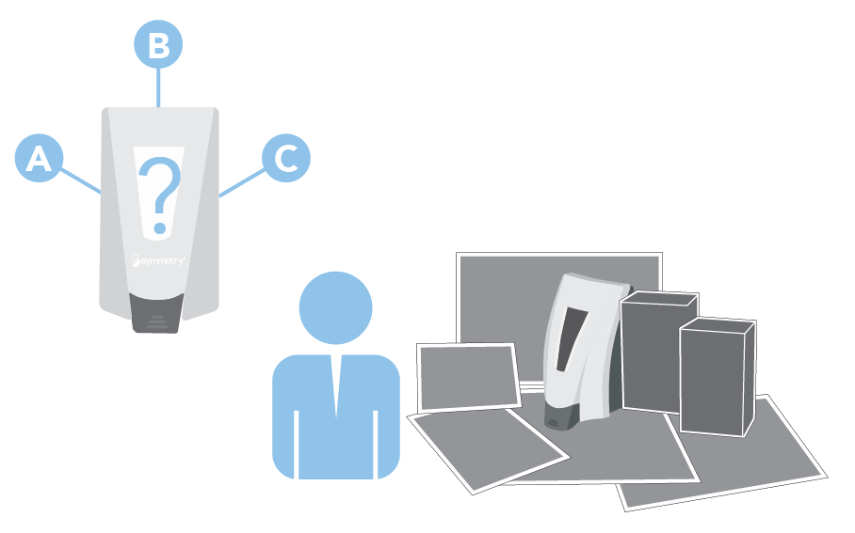
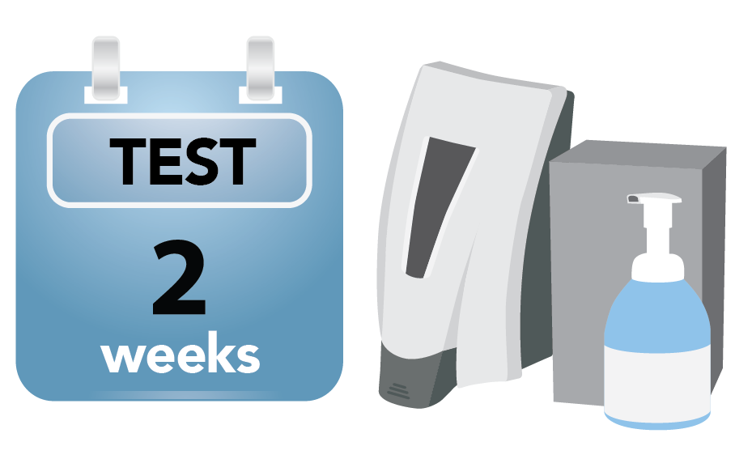


Symmetry Try & Buy Program
The Symmetry Try & Buy Program is a great way for you to gather valuable feedback from the people using your hand hygiene products.
1
2
3
Your Symmetry representative will work with you to determine where Symmetry dispensers will be installed for testing.
Your Symmetry representative brings the appropriate Symmetry dispensers, hand hygiene products, and surveying tools.
Test Symmetry hand hygiene products and gather feedback. Each Symmetry dispenser will have a feedback sticker attached with your contact information on it.
Once product testing and evaluation are complete, meet with your Symmetry representative to review results and general feedback.

