Slide 1
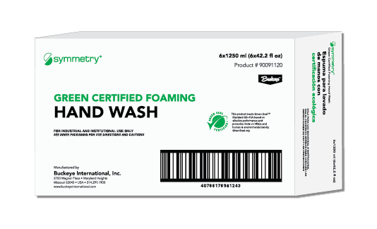
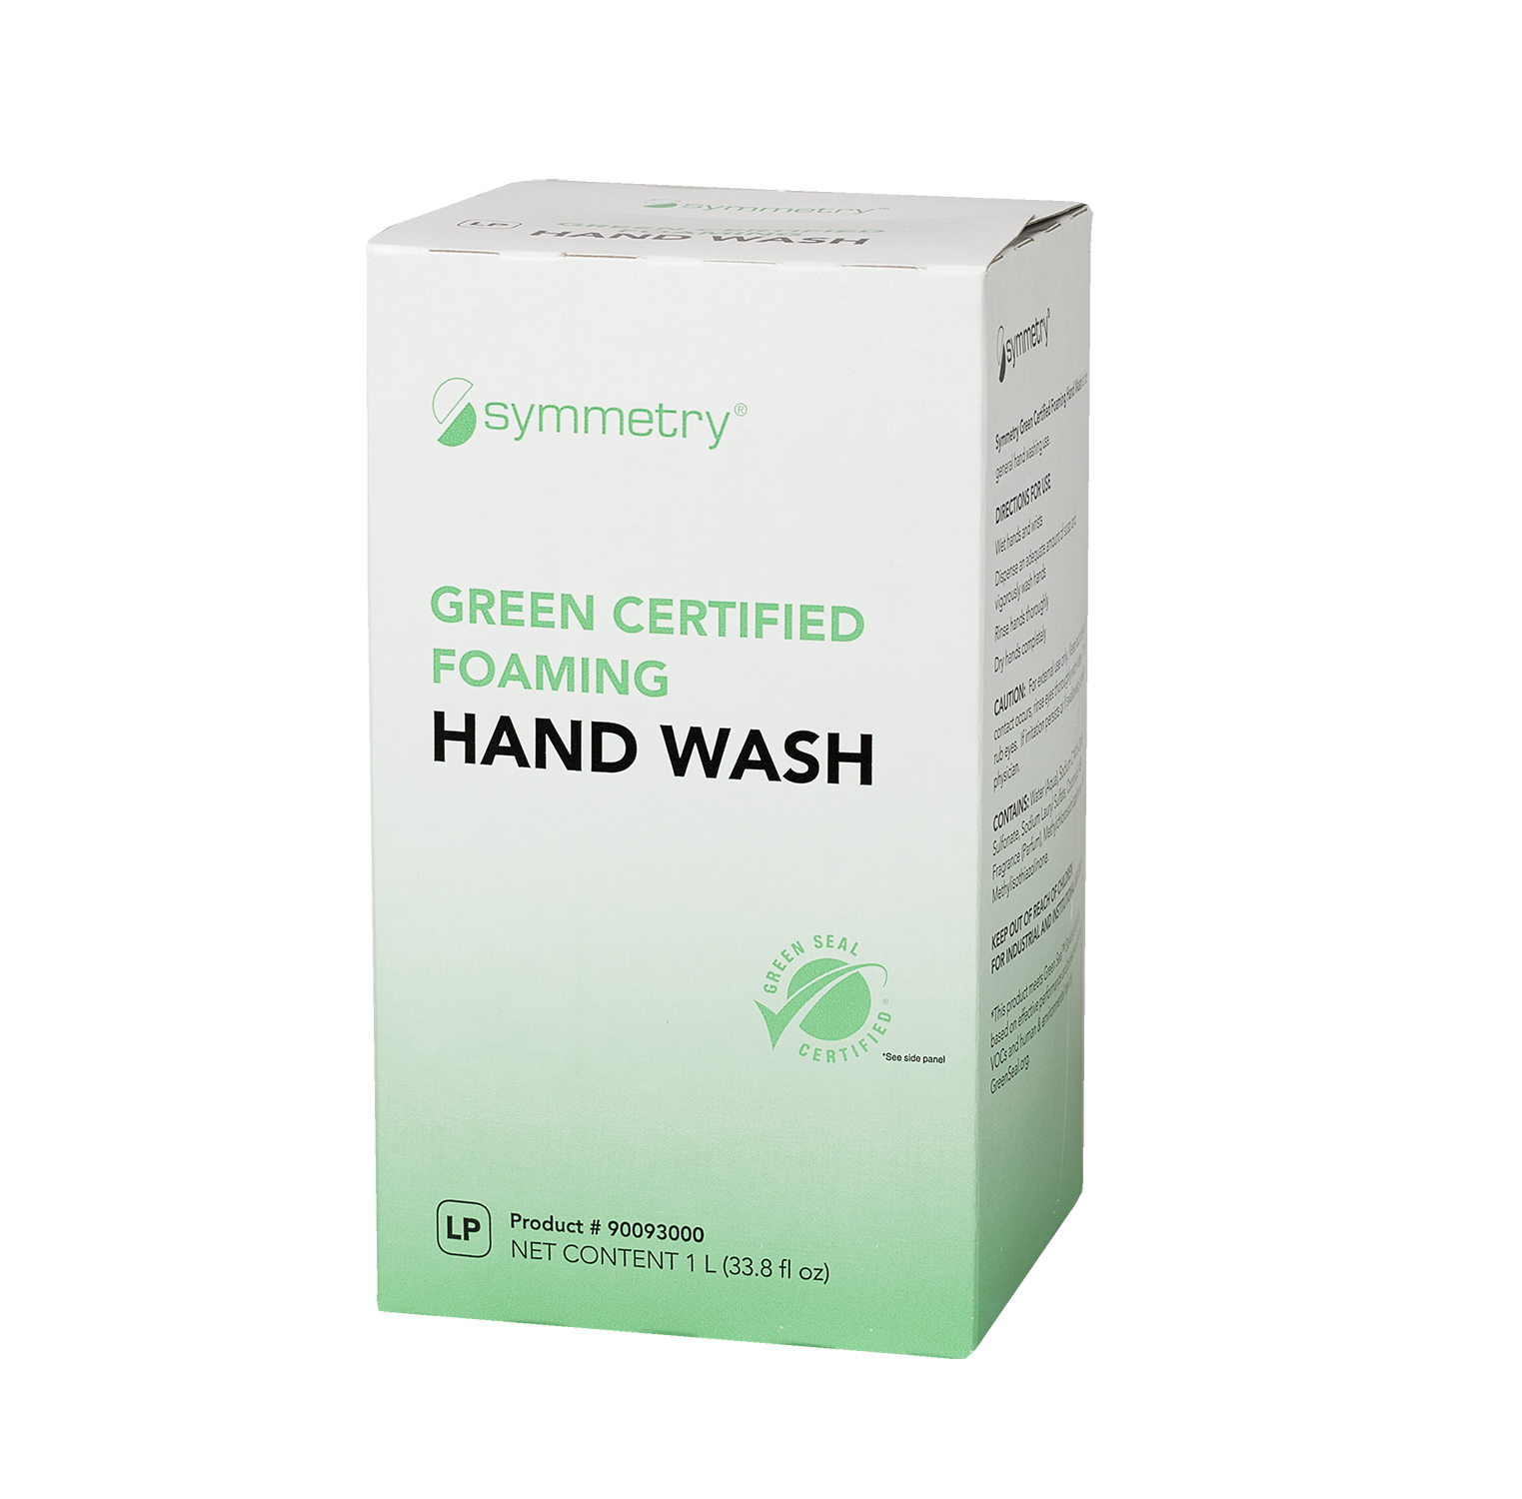
SUSTAINABILITY
Packaging
Symmetry Outer Box Packaging
Symmetry Inner Carton Packaging
One ton of paper from recycled pulp saves:
17
4,200
kWh
(enough to heat a home for 6 months)
3
cubic yards
130 tons (261,233 lbs) of recycled content
41% recycled material
96.6 tons (193,224 lbs) of paper diverted from the landfill
35% minimum post-consumer material diverted from the waste stream at the end of its intended lifecycle
390
7,000
gallons of
2,220 trees saved
gallons of
1,175 cubic yards of landfill space
Recycling 1 ton of cardboard saves over nine cubic yards of landfill space
Over the past year, based on this recycling information, Symmetry:
50,934 gallons of oil
7,836 pounds of air pollutants
https://www.rpa100.com/why/benefits/
Saved enough energy to heat 276 average sized US homes for a year
Reduced air pollution equivalent to removing 1,656 18-wheelers from the road
Reduced emissions of greenhouse gases equivalent to removing 14,904 automobiles from the road
Prevented the production of 1,932 Olympic-sized swimming pools worth of waste water
https://bit.ly/2Gi08qo

